Slide 1
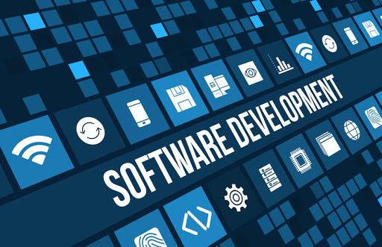
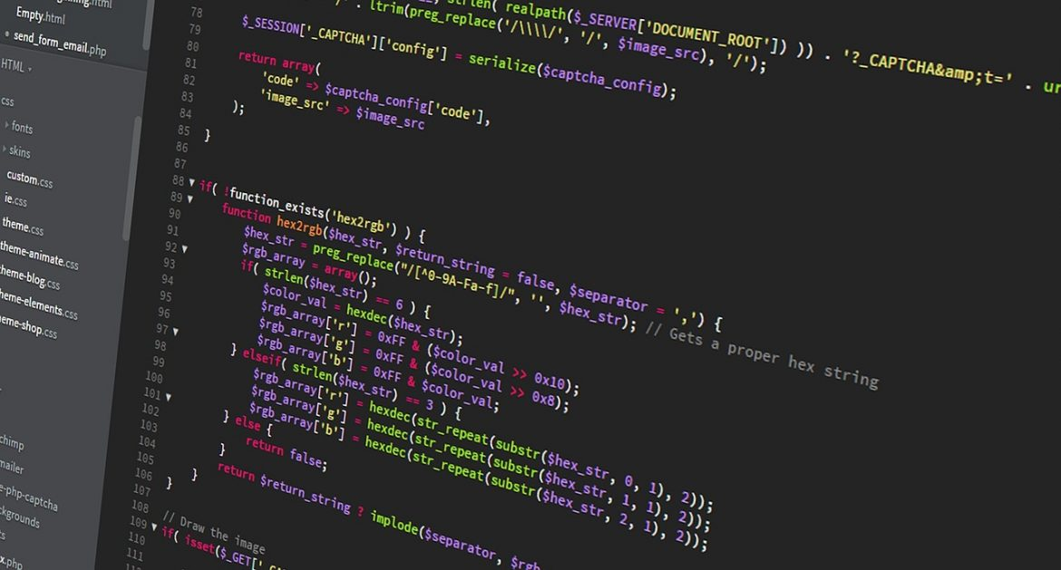
Software Development Concepts
Fundamental Concepts and Paradigms in the Software Engineering Profession
SoftUni Team
Technical Trainers
Software University
https://softuni.bg
Notes:
Hello everyone. Welcome to the "Software Development Concepts" lesson from the "Programming Fundamentals" training course at SoftUni.
I am doctor Svetlin Nakov, senior technical trainer and co-founder of SoftUni and I will teach this lesson.
I will introduce you to the most important fundamental concepts, principles and paradigms of the "software engineering" profession.
I will start with the 4 essential skills of software engineers and will explain how the main concepts of computer science and software development are related to the software engineering profession.
Then, I will briefly present some of the most important concepts and paradigm of software development like object-oriented and functional programming, component-based and event-driven programming, libraries and frameworks, software architectures, front-end and back-end, databases, Web development concepts, operating systems, virtualization and cloud, software development methodologies, quality assurance and others.
I have limited time, so I will only mention most of these concepts without a solid explanation, because it takes years to master them.

Slide 2
Table of Contents
The 4 Skills of the Software Engineers
Fundamental Software Engineering Concepts
Math Concepts in Software Development
Object-Oriented Programming (OOP)
Functional Programming (FP)
Data Structures and Algorithms
Component-Based Development and Event-Driven Programming
Asynchronous Programming and Promises
Software Architectures, Front-End and Back-End
2
Notes:
This is what I plan to mention in my talk.
I will start with a detailed explanation of the 4 essential skills of software engineers: coding skills, algorithmic thinking and problem solving, software development concepts and principles and software technologies.
Then I will introduce you with several fundamental software engineering concepts, principles and paradigms:
Math concepts in software development, related to programming and certain software technologies
Object-oriented programming (OOP), the concept of classes, objects, interfaces, inheritance and polymorphism
Functional programming (FP), pure functions, first-class functions and higher-order functions
Data structures (linear, tree-like structures, hash tables) and algorithms
Component-based development and component libraries
Event-driven programming, event sources and event handlers
Asynchronous programming, multithreading, parallel execution and promises

Slide 3
Have a Question?
sli.do
#fund-common
Notes:
In case you have any question,
feel free to ask in the sli.do platform using the code on the screen,
and the trainers will be happy to answer you very soon.

Slide 4

The 4 Skills of Software Engineers
Notes:
In this section I will explain the four essential skills of software engineers:
Coding skills, algorithmic thinking and problem-solving skills, understanding software engineering concepts and principles and mastering software technologies.
These are the 4 main skill groups that all programmers must have in order to practice software development successfully.
Most of these skills are sustainable over time and are not affected by the advances of the technologies (that are constantly changing).
I will explain in detail these four essential groups of skills, with focus on the concepts, principles and paradigms of computer science and software development.

Slide 5

Skills of the Software Engineers
4 main groups of technical skills:
Coding skills – 20%
Algorithmic thinking – 30%
Fundamental software development concepts – 25%
Programming languages and software technologies – 25%
Notes:
There are 4 main groups of skills, that any skillful programmer has and to which every beginner must strive:
Coding skills, which form 20% of the developer skills, are the skills to write and debug code and use developer tools.
These skills include working with data and calculations, using loops and basic data structures like arrays and lists, using objects and programming APIs.
The algorithmic thinking and problem-solving skills, which form 30% of the developer skills, are the skills to solve technical problems by:
analyzing the problem and generating ideas how to solve it,
designing a sequence of steps (called algorithm) to obtain the expected results from the input data
and implement the steps to build the solution.
The fundamental software engineering concepts form about 25% of developer skills.
These skills include many programming paradigms, essential software development knowledge and skills, software engineering principles and concepts that developers typically acquire as they gain experience over time.
These skills include object-oriented and functional programming, data structures and algorithms, networking and Web, front-end and back-end concepts, databases, source control systems and team working.
Programming languages and software technologies (which form only 25% of the developer skills) are what we see at the job offers for developers.
Front-end technologies like HTML, CSS, JavaScript, Angular and React
Back-end technologies like C# and ASP.NET MVC, Java and Spring framework, Python and Django, JavaScript and Node.js
Database technologies like SQL Server, MySQL and PostgreSQL and ORM frameworks like Entity Framework and Spring Data
I will explain these 4 groups of technical skills in more detail, because they are the heart of what beginner developers need to master to start their first job.

Slide 6

Skill #1: Coding (20%)
The skill to write code
Working with commands, IDE, variables, data and calculations, conditional statements, loops
Using functions (or methods) and objects
Working with data structures (arrays, lists, maps and others), libraries and APIs
Courses at SoftUni: softuni.bg/curriculum
Programming Basics, Programming Fundamentals
The programming language doesn't matter!
Notes:
Coding skills form 20% of the developer skills.
These are the skills to write and debug code and they include the following components:
Coding (writing commands, scripts and programs), using development environments (the so-called IDEs) and developer tools
Working with variables and data, calculations, using conditional statements and loops
Writing and using functions, methods, classes and objects
Working with data structures, such as arrays, lists, maps, strings, and trees
Using programming APIs, libraries and software packages
Troubleshooting and debugging the code and using a debugger
The skill of coding can be acquired after several months of hard learning and solving practical problems and writing code every day.
At SoftUni the coding skills are mastered in the first few training courses of our end-to-end software engineering program:
in the "Programing Basics" training course,
in the "Programming Fundamentals" course,
and in the next few courses, where these skills are further developed.
Remember that the programming language does not matter for the ability to code.
Coding is essential skill, which once learned, can be applied in many programming languages.
To master the skill of coding, you need to invest 2 or 3 months of intensive training and coding every day or learn slowly for а longer period.

Slide 7

Skill #2: Algorithmic Thinking (30%)
Algorithmic (engineering, mathematical) thinking
The ability to analyze problems and find solutions
Breaking the problem down to steps (algorithm)
How to develop algorithmic thinking?
Solve 1000+ programming problems
It takes 6 to 12 months of coding every day
Courses in SoftUni: Programming Basics, Fundamentals and Advanced Modules
The programming language doesn't matter!
Notes:
The second essential skill of software developers is algorithmic thinking and problem-solving (which forms 30% of the developer skills).
Algorithmic thinking is a way of getting to a solution through the clear definition of the steps needed.
It includes the ability to analyze the problem and break it into a logical sequence of steps (called "algorithm"), to find a solution for every separate step (or break it further into sub-steps) and then assemble these steps into a working solution.
The algorithmic thinking is similar concept to logical thinking, engineering thinking, mathematical thinking and abstract thinking.
All these concepts are related to the ability to solve problems: to think logically, to analyze the problems, and to find and implement solutions.
That's why good mathematicians, physicists, architectural or mechanical engineers can easily learn programming and software development: they have strong engineering thinking and problem-solving skills.
Others may also learn algorithmic thinking and software development, but they will need more time.
"Problem solving" is more general skill, while "algorithmic thinking" is more technical (or engineering) skill.
Problem solving is the act of defining a problem; determining the cause of the problem; analyzing the problem; identifying, prioritizing, and selecting alternatives for a solution; and implementing a solution successfully.
In computer science we deal with "technical problem solving", which is the most important skill of any programmer: the ability to solve technical problems by breaking them into sequences of steps and implementing these steps with code.
To master the skill of solving technical problems and develop algorithmic thinking, it is necessary to invest 6-12 months of intensive training and practicing every day and to solve at least 1000 practical programming problems.
At SoftUni algorithmic thinking and problem solving are mastered during the "Programming Basics" and the "Programming Fundamentals" courses and in the Advanced programming modules (in the professional tracks) and are later extended in the optional "Data Structures and Algorithms" module.
The programming language and software technologies doesn't matter for the algorithmic thinking and problem-solving skills.
Developers with strong algorithmic thinking will be able to design and implement algorithms in any programming language.
These are essential skills that once learned will help you throughout your life. They do not age over time.

Slide 8
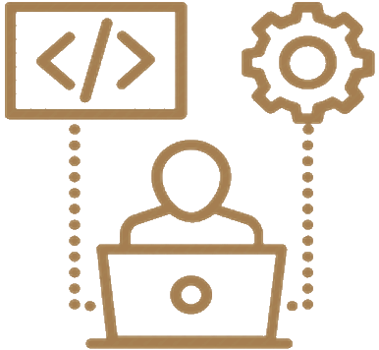
Skill #3: Fundamental Concepts (25%)
Fundamental software development concepts
Object-oriented programming (OOP)
Functional programming (FP)
Asynchronous programming and parallel execution
Databases: relational DB, SQL, document DB, key-value model
Web technologies: HTTP, JS, DOM, AJAX, REST, …
Software engineering: source control, agile, …
SoftUni Curriculum: Professional Modules
The programming language doesn't matter!
Notes:
The fundamental computer science and software engineering concepts and principles form about 25% of developer skills.
These are the skills that we will mention in this lesson and that developers are learning for many years during their software engineering education and professional career.
These fundamental computer science and software development concepts include many programming paradigms, essential software development knowledge and skills, software engineering principles and concepts.
Some of these knowledge areas and concepts are the following:
The concept of object-oriented programming (OOP), working with classes, objects, inheritance, interfaces and polymorphism
The concept of functional programming (FP), working with pure functions, declarative programming and immutable data
The concept of asynchronous programming and concurrent execution, working with threads, background tasks, promises and others
Databases: relational databases, the entity-relationship model, the SQL language, as well as NoSQL databases, document-oriented databases, the key-value model, database engines, programming APIs and tools for database programming and ORM frameworks
The concepts behind the networking and Web technologies: the HTTP protocol, front-end Web development (HTML, CSS, JavaScript, DOM, AJAX, REST), back-end Web development, MVC frameworks, routing engines, templating engines, cloud technologies, and many others
Software engineering: development methodologies, agile principles, teamwork principles, source control systems, project management principles, quality assurance, and others
The basics of all these software development principles and engineering concepts are learned in the professional modules from the SoftUni curriculum (see softuni.org/curriculum).
It takes 1-2 years of specialized training and practical software development to learn the basics of these fundamental software development concepts.
Developers learn these concepts in greater detail for many years, as they gain more and more experience during their professional career path.
These principles of software engineering and development paradigms are independent of programming languages and specific technologies.
The programming language does not matter for the assimilation of all these skills.
These concepts are highly stable over the time: once learned, they don't change significantly for decades.

Slide 9

Skill #4: Languages & Technologies (25%)
Programming language and technologies
They only form 25% of the skills of a programmer!
The programming languages and technologies come always together (as a technology stack)!
Example of skills required for a Junior C# / .NET Developer:
C# + .NET Core + Visual Studio + databases + SQL Server + SQL + EF + ASP.NET MVC + HTML + CSS + JS + AJAX + REST + JSON + OOP + FP + algorithmic thinking + Git + software engineering + English + teamwork skills
Software technologies change very fast!
SoftUni Curriculum: Professional Modules
Notes:
Programming languages and software technologies (which form only 25% of the developer skills) are what we see at the job offers for developers.
Programming languages (such as JavaScript, C# and Python), software development technologies (such as React, ASP.NET Core and Django), software platforms (such as Java EE and .NET Core), software libraries (such as Apache Commons and ML.NET), development frameworks (such as Spring MVC and Angular) and developer tools (such as npm, Visual Studio, Webpack and Maven) are what we can see in the requirements in most job offers for software developers, but they are the last 25 percent of the developers' skills.
The other 75% of the developer skills are coding, algorithmic thinking, and development concepts, which are considered to be mastered by the job offers.
That's why many job offers for junior devs require 1-2 years of experience: because this experience guarantees good coding skills, at least basic algorithmic thinking and problem-solving skills and at least basic level of understanding the main development concepts and principles, together with certain stack of software technologies.
The programming languages and technologies always come, as a technology stack (or software development stack).
Development stacks are sets of related programming languages, software technologies and tools, which are used together.
The term "stack" is used because some technologies depend directly on others and work on top of each other like a stack.
"Development stack" simply means the set of languages, platforms, frameworks, libraries, IDEs and tools used for application development, including the operating system, the software or cloud platform, database server and application server.
Examples are the LAMP stack (Linux + Apache + MySQL + PHP) and the Django stack (Python + Django + PostgreSQL).
Here are some more detailed examples of commonly used software development stacks which software companies are looking for:
The .NET development stack (which is required for starting a job as a junior C# developer) consists of: C# + .NET Core + Visual Studio + databases + SQL Server + SQL + Entity Framework + ASP.NET MVC and Web API + HTML + CSS + JavaScript + AJAX + RESTful services + JSON + object-oriented programming + functional programming + algorithmic thinking + source control systems and Git + software engineering + cloud + containers + English and teamwork skills
Another popular development stack is JavaScript + functional programming + object-oriented programming + databases + MongoDB or MySQL + HTTP + web programming + web front-end (HTML with CSS, JavaScript, DOM and jQuery or Angular or React) + web back-end (Node.js and Express) + JavaScript tools + cloud + containers
Another popular technology stack from the Python ecosystem is: Python + object-oriented programming + functional programming + databases + MongoDB or MySQL or PostgreSQL + HTTP + web development + HTML + CSS + JavaScript and DOM + jQuery + some MVC framework like Django or Flask + cloud and containers
In the Java space we have development stacks based on the following technologies: Java + Java API classes + object-oriented programming + functional programming + databases + MySQL + HTTP + web programming + HTML + CSS + JS + DOM + jQuery + JSP and Servlets + Spring MVC or Java EE + cloud and containers
All these technologies consist of large amount of technical knowledge, which change very fast.
Once you learn a software technology, such as Angular 9 or Java EE 8, it will be outdated in few years or even months and new versions or entirely new technologies will come as replacement. This is normal! Live with the understanding that technology is changing fast. What stays for long are the coding skills, algorithmic thinking and software development concepts and principles.
The usual lifetime of modern software technologies is 2-3 years.
At SoftUni we teach modern software technologies in the professional modules of our end-to-end training program for software engineers.
We combine learning of modern software technologies together with fundamental development concepts and principles and problem-solving skills.
In the professional modules at SoftUni we focus on certain development stack (based on C#, Java, JavaScript, Python or other language) and we gain experience with it through a lot of exercises and practical projects.
Remember that software technologies are only 25% of the developer skills and are highly dependent on the previous 75%, the general software development skills, which are:
Strong coding skills;
Algorithmic thinking and technical problem solving;
Computer science and software development concepts;
Many job offers for developers only publish a list of software technologies without even mentioning the coding skills, problem-solving skills and development concepts and principles.
This is because employers assume that all developers should have these 4 groups of skills and that experience with software technologies proves that the applicant has also coding skills, algorithmic thinking and problem-solving skills and understands the concepts and principles behind the modern software technologies.
To be a software developer, you need to have all these 4 groups of essential developer skills.
You should learn them: either from your experience, or from trainings and courses, from books or from all these sources combined.
In addition to the tech skills, developers should have also soft skills, such as:
Verbal and written communication skills
Teamwork skills – the skill to work successfully with other people
Organizational skills, time management, planning and prioritization
Accountability, empathy, adaptability, creativity, attention to detail and many others
All these technical and non-technical skills, combined together,
are described in the job offers under this short and simple requirement:
"1 or 2 years of professional developer experience".

Slide 10
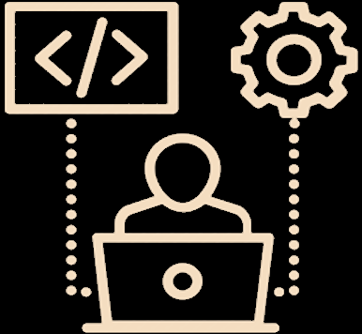
Fundamental Software Engineering Concepts
Notes:
Let's make a review of the most necessary concepts and principles of software engineering, including
math concepts for developers, procedural, object-oriented and functional programming, data structures and algorithms, component-based and event-driven programming, asynchronous programming, networking, software architectures and the client-server model, the concept of front-end and back-end, Web front-end, DOM and AJAX, back-end and RESTful services, templating engines, routing, user interface libraries and frameworks, databases and object-relational mapping, the model-view-controller paradigm, embedded systems and Internet of things, mobile apps, virtualization and cloud, containers, operating systems and the Linux shell, development methodologies, project tracking, source control systems, unit testing and quality assurance.
These fundamental computer science and software development concepts include many programming paradigms, essential software development knowledge and skills, software engineering principles and concepts, which developers learn through their formal and informal education and later at their job, as they get more and more practical experience as software developers.

Slide 11
Math Concepts in Software Development
Basic mathematical concepts related to programming
Coordinate systems (used in computer graphics)
Mathematical functions (lambda calculus, discrete functions, …)
Vectors and matrices (used in graphics, machine learning, …)
Finite state automata and state machines (used in parsers)
Statistics concepts (used in machine learning)
Algorithm complexity (estimate the speed)
Mathematical modeling
Notes:
Simple mathematical concepts are often needed and applied in software development.
This doesn't mean that software developers should be strong mathematicians, but they should be familiar with the basic math concepts at school level.
Developers don't need to prove theorems or solve differential equations, but they need to understand coordinate systems, they need to know what a function is, they need to be able to perform simple calculations, and they need to have well-developed algorithmic thinking, which is like the logical thinking used in math.
School-level math is enough for most developers, unless they are involved with computer graphics, machine learning or other math-intensive specialization.
Below are the most important mathematical concepts related to programming:
Coordinate systems and graphical objects with their size, position and other numerical characteristics are used in computer graphics and user interface systems, such as HTML and CSS, PDF, SVG and others.
Mathematical functions, elements of lambda calculus, discrete functions and other simple mathematical transformations are used by developers when they write code, as part of the functional programming paradigm and some modern architectural approaches like "serverless computations".
For example, developers may define functions in their programming language, which transform input values into an output result,
Or they can pass a function (called a callback or delegate) as a parameter to other function.
Vectors and matrices may be used in graphics, machine learning, and everywhere else.
In fact, developers are using vectors every day, because "vector" is the mathematical name of "arrays and lists".
"Matrices" is the mathematical name of "tables" that we know well from spreadsheet and Excel applications.
Finite state automata and state machines are used in parsers (which extract data from structured text), in process management and workflow management software and in interpreters and compilers.
Statistics concepts, such as probability distributions, statistical significance, hypothesis testing, and regression are widely used in data science and machine learning.
In machine learning, data science and artificial intelligence systems, math skills are more important.
But in traditional (mainstream) Web, mobile and back-end development, we need nothing more than school-level math and logical thinking.
Algorithm complexity is a math concept from the mathematical analysis, used to estimate the execution speed of the code, based on the approximation of the steps needed to be executed.
Developers need to learn the concept of "time complexity" and what is linear time, quadratic time, cubic time and logarithmic time, which is quite simple, and mathematics is not deeply involved.
Mathematical modeling is the art of translating problems from an application area into tractable mathematical or formal formulations whose theoretical, numerical and algorithmic analysis provides insight, answers, and guidance useful for the originating application.
Mathematical modeling is important skill, related to algorithmic thinking and developers with strong problem-solving skills learn how to use it at basic level.

Slide 12
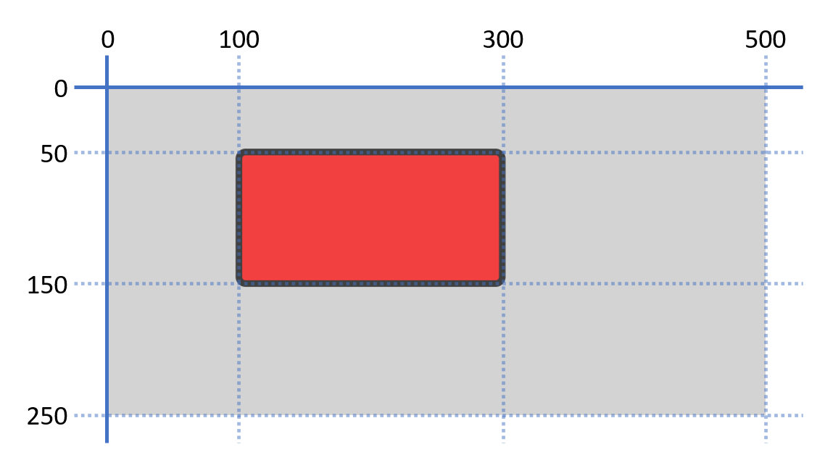
Coordinate System and SVG – Example
<svg width="500" height="250" style="background:lightgray">
<rect x="100" y="50" width="200" height="100" rx="5" ry="5" style="fill:red;stroke:black;stroke-width:5;opacity:0.7" />
</svg>
Notes:
This is an example of how basic school-level mathematical skills are used to draw objects using SVG (scalable vector graphics) – the vector graphics standard for the Web.
We draw a rectangle at certain position at the coordinate system, with certain size, border width and border radius.
Developers use similar concepts when they create the user interface of their apps, using HTML and CSS or XAML or other graphical representation technology.

Slide 13
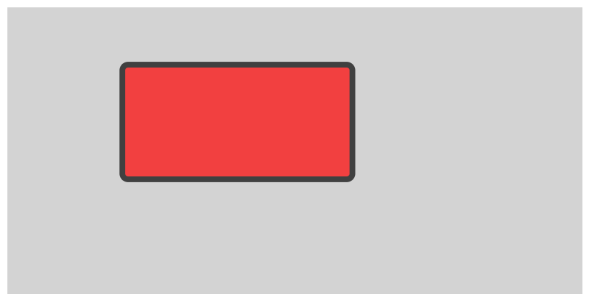
SVG and the Coordinate System
Live Demo
https://repl.it/@nakov/SVG-example
Notes:
Now, let’s see the previous example in live demonstration.
We open repl.it, where I have prepared code for the SVG example.
And we click the green [Run] button.
Now we see the red rectangle with the black border.
It is located at the invisible coordinate system, which starts at the top left corner of the Web page, which hosts the SVG graphical area.

Slide 14
Object-Oriented Programming (OOP)
Object-Oriented Programming (OOP) is the concept of using classes and objects (class instances) to model the real world
Class definition
class Rectangle {
int width, height;
int CalcArea() { return width * height;
}
}
width = 5
height = 6
width = 6
height = 4
Fields (data)
Methods (actions)
width = 7
height = 3
Objects
Notes:
Object-oriented programming (OOP) is the concept of using classes and objects to model the real world.
Classes are sets of data fields, together with methods (which are functionality to interact with the data fields and other objects).
Classes define the structure of information objects: the data they holds and the operation they can perform.
Objects are instances of the classes, holding certain values in their data fields.
At the example we have a definition of the class "Rectangle".
It holds two data fields: width and height. – integer values.
It defines a method, holding the code to calculate the area of the rectangle.
This is the class definition … and the programming language here doesn’t matter.
These are the definitions of the data fields, which the class holds in each object.
These are the methods of the class: the operations or actions that objects of this class can do.
And now we have several objects of this class "Rectangle".
The first object is a rectangle of width 5 and height 6.
Another object has width 6 and height 4.
Some other object has width 7 and height 3.
We have one class "Rectangle" and 3 objects (or instances) of this class.
The class holds the definition (the specification, the model, the template) for the objects.
It defines the data fields and methods and more details (in some cases).
Classes don't hold data. They hold data definitions and operation definitions.
Objects hold values for the data fields in the class.
Objects of class "Rectangle" hold data about certain rectangle.
Objects are information structures, holding data.
Typically one class has multiple objects (or instances).
Classes and objects are the building blocks of the object-oriented programming (OOP) and they come together with some other OOP concepts like abstraction, interfaces, data encapsulation, inheritance, polymorphism and exception handling.

Slide 15

Object-Oriented Programming (OOP)
Live Demo
https://repl.it/@nakov/rectangle-oop-js
https://repl.it/@nakov/rectangle-oop-cs
Notes:
I have prepared examples of classes and objects in C# and JavaScript.
We can open the JavaScript example.
Wait a bit for the code to load.
It takes time…
Now we click [Run] and we see several rectangles (objects of class "Rectangle") together with their data field values and the calculated area.
The rectangle area is calculated by a method "calcArea" in the class.
This is the class definition.
And this is how we create objects.
I will not be able to get into more details at this moment.
Now the concept is important, not the implementation and the code.
The concept is that in programming we can define classes, which model real-world entities.
They hold data (properties) and operations, just like in the real world.
Objects are instances of the class definition with certain data characteristics, just like objects in the real world.
We shall learn more about defining and using classes in the "Object-Oriented Programming" course at SoftUni.
We have the same code in C#, which works in a very similar way.
If you are curious, you can look at the sample code in detail and play with it.

Slide 16
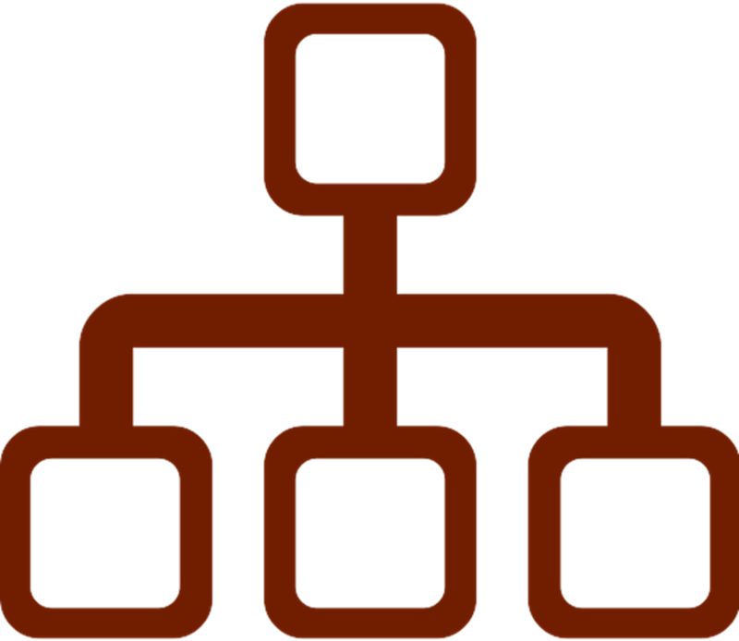
Inheritance and Interfaces
Inheritance allows classes to inherit data and functionality from a parent class (base class)
Interface – defines abstract actions
Actions to be implemented in descendent classes
Abstract class – abstraction, e.g. Figure
Defines data + actions + abstract actions
Concrete class – e.g. Circle, Rectangle
Defines data + concrete functionality
Notes:
Inheritance and interfaces are two other major concepts in the object-oriented programming.
Inheritance allows classes to inherit data and functionality from a parent class (also called "base class").
When a class inherits another class, the parent class fields are merged with the child class fields and they together form the set of data fields for the child class.
Interfaces defines abstract actions.
These are actions to be implemented in the descendent classes.
Interfaces define a set of empty (or abstract) methods (or actions),
which shall be obligatory implemented in the child classes.
Interfaces are also called "contracts", because they define certain set of functionalities, a contract to implement certain methods.
Abstract classes are used to model abstractions.
For example, the class Figure is not a concrete figure like square or rectangle, but the concept or the abstraction of "figure".
Abstract classes defines data + actions (or normal methods) + abstract actions (or empty methods).
Abstract classes are designed to be inherited (or extended).
Concrete classes like Circle and Rectangle represent real entities, not abstractions.
Concrete classes define data fields + concrete functionality (methods).
They can implement interfaces and inherit abstract and other classes.

Slide 17
Inheritance and Interfaces – Example
Base abstract class
abstract class Figure {
int x, y;
abstract int calcArea();
}
Abstract method
Child class
class Circle extends Figure {
int radius;
override int calcArea() =>
PI * radius * radius;
}
class Rectangle extends Figure {
int width, height;
override int calcArea() =>
width * height;
}
Notes:
In this example we demonstrate abstract classes and concrete classes.
This is an example of abstract class, which models an abstraction "Figure".
It defines two data fields: x and y.
It defines also an abstract action (or method) for calculating the area of the figure.
This method is empty (or abstract), because it is specific to the concrete figure, like "circle" or "rectangle".
In the child (or descendent) classes this abstract action will become concrete, it will hold the code to calculate a circle area or rectangle area or other, depending on the concrete figure.
This abstract class models the generic abstraction "Figure" and child classes will determine the type of the figure.
This is the definition of the base abstract class.
Don't focus on the programming language, we talk about concepts now.
This is the definition of an abstract method, which returns an integer value.
Again, don't care about the programming language.
Different programming languages have different syntax, but the concepts remain the same.
This is an example of child class "Circle" – a class which inherits from the abstract class "Figure".
It inherits the fields "x" and "y" from "Figure" and appends an additional field "radius".
This way the child class has 3 fields: two inherited from the parent class and one defined additionally.
The class Circle defines a concrete implementation of the abstract method "calcArea", which calculates the circle area using the well-known formula from the school-level math.
This is an example definition of another child class "Rectangle", which inherits from the same base class Figure.
The "Rectangle" class defines two additional fields: width and height.
It provides different concrete implementation of the "calcArea" abstract method, which calculates the rectangle area.
This is a very good example of abstract and concrete classes.
Abstract classes model common (or generic) data and functionality, and concrete classes model concrete entities and concrete implementations of the abstract actions from the parent class.
The programming languages doesn’t matter.
This configuration of parent class + child classes is an important concept from the object-oriented programming,
which we shall learn in detail later in SoftUni.
This example illustrates two main object-oriented programming concepts: inheritance and polymorphism.
These are complex concepts and here I just want to mention them.
We shall learn them later with a lot of practice.

Slide 18
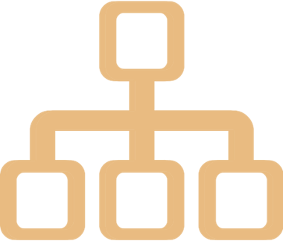
Inheritance in OOP
Live Demo
https://repl.it/@nakov/inheritance-oop-js
https://repl.it/@nakov/inheritance-oop-cs
Notes:
We can play with the example that I have prepared to illustrate abstract classes and inheritance:
Abstract class Figure + two child classes: Circle and Rectangle.
Let's see this in repl.it.
I will open the first code link.
And it takes some time to load…
Now I run it and the result is shown on the right.
We have two objects: a rectangle and a circle, which have certain location and size, and their area is also calculated and printed.
This is the base class "Figure".
This is the child class "Rectangle",
and the child class "Circle".
And this is how we use these classes.
I will not spend more time to explain this sample code in detail,
because I just want to briefly introduce the idea of inheritance in the object-oriented programming,
not to teach you writing object-oriented code in JavaScript, C# or other language.
For those of you, who are more curious, you can look at the sample code in detail and play with it.
This is the same code in C#.
And it produces similar results.

Slide 19

Functional Programming
Functional programming (FP)
Programming by composing pure functions, avoiding shared state, mutable data, and side-effects
Declarative programing approach (not imperative)
Program state flows through pure functions
Pure function == function, which returns value only determined by its input, without side effects
Examples: sqrt(x), sort(list) → sorted list
Pure function == consistent result
Notes:
Let's continue with another important paradigm in modern programming: functional programming.
Functional programming (FP) is programming based on composing pure functions, while avoiding shared state, mutable data, and side-effects.
Functional programs are sequences of transformations of data through functions.
In pure functional programming functions and programs don't have state, which means that functions do not hold shared data.
They only access their input arguments and return an output.
I will give you examples later.
Functional programming is declarative programing approach (not imperative),
which means that instead of describing an algorithm how to do something step by step,
functional developers describe the result by functions and compositions of functions.
The program state flows through pure functions, where one function passes its output data as input to other function.
I will illustrate how this happens with examples later.
What is a "pure function"?
It is a function, which returns value only determined by its input, without side effects.
Printing something at the console or storing something in a database are examples of side effects.
Therefore, using pure functional programming is often impractical.
Modern languages use elements of functional-style programming and are not purely functional.
Examples of pure functions are:
the square root function: "sqrt of x", which takes a number as input and returns another number as output,
and the function "sort of list", which takes a list as input and returns a new list as output.
Both functions have no side effects:
they don't change anything;
they don't read or write external data;
and they do not use state.
They are pure functions.
Pure functions are the heart of the functional programming.
Using "pure functions" means maintaining "consistent results".
If you invoke a pure function many times with the same input data, it will have the same consistent behavior and will return the same result, because it have no state and no interaction with the external data or components.
Pure functions produce predictable results and behavior and sometimes their correctness can be mathematically proven.
This is the most important principle in functional programming:
to build programs by composition of stateless pure functions without side effects.

Slide 20
Functional Programming Languages
Purely functional languages are unpractical and rarely used
The program is pure function without side effects, e.g. Haskell
Impure functional languages
Emphasize functional style, but allow side effects, e.g. Clojure
Multi-paradigm languages
Combine multiple programing paradigms: functional, structured, object-oriented, …
Examples: JavaScript, C#, Python, Java
Notes:
There are many functional programming languages and languages that incorporate functional paradigms into modern software development.
Most modern languages are not functional, but support concepts for functional programming.
Purely functional languages are unpractical and rarely used, because it is more complicated to program without maintaining a state.
Purely functional developers need to switch their thinking style from the traditional "algorithmic thinking" to "functional thinking".
The program in the purely functional languages is a pure function (which calls other pure functions) without side effects.
An example of purely functional language is Haskell, which is not widely used in practice,
but it has a great value in learning the functional programming paradigms.
Impure functional languages are used more often because they allow exceptions from the concept of "pure functions" and simplify the work of developers.
These languages emphasize the functional style but sometimes allow side effects.
An example of impure functional language is Clojure.
It is not very popular in practical software development.
Multi-paradigm languages combine the strengths of both the functional and the algorithmic (or imperative) world.
Most of today's widely used general-purpose programming languages are multi-paradigm.
They combine multiple programing paradigms: functional programming, declarative programming, structured programming, imperative programming, object-oriented programming, component-based programming, event-driven programming, asynchronous programming, and many others.
Examples of popular general-purpose multi-paradigm programming languages are:
JavaScript, C#, Python, Java, PHP, C++, Go, Swift and TypeScript.
All these languages combine multiple concepts and paradigms for structuring the program to simplify the work of developers and improve their efficiency and performance.

Slide 21
Functional Programming – Examples
Read several numbers and find the biggest of them (in C#)
Functional style
Imperative style
Console.WriteLine(
Console.ReadLine()
.Split(" ")
.Select(int.Parse)
.Max()
);
var input = Console.ReadLine();
var items = input.Split(" ");
var nums = items.Select(int.Parse);
var maxNum = nums.Max();
Console.WriteLine(maxNum);
Notes:
This is an example, which demonstrates the functional style of programming, compared to the traditional imperative (or structured) programming style.
We want to write a C# program to read several numbers, find the biggest of them and print it.
To solve this problem in a functional style, we can write the following code:
We print the result, which will be calculated by a function, using another function: Console.WriteLine.
We read the input text from the console, by invoking a function: Console.ReadLine.
Then we split the result from the previous function (the input text) into space-separated elements (which are strings).
Then we parse each of these input strings to integer numbers.
We use the mapping function in C# (Select).
It takes as an input a sequence of strings and maps it through another function (int.Parse).
The result from this function is a sequence of integers.
Finally, we find the biggest number from the list of numbers,
using the Max function.
Each subsequent step takes as input the result of the previous step and transforms it into another result.
This is the power of functional programming: to use a composition of functions to process certain data and obtain certain results.
This functional style of writing expressions to build or compute something is very common in modern programming and can be seen in many programming languages, frameworks and libraries.
Now, let's see the equivalent imperative style for the same program, again in C#.
This is a piece of code, written in a structured programming style, or a procedural style.
It consists of sequence of commands and each command takes its input from a variable, calculates a new result and stores it in a variable.
This is the first command: reading the input text.
The next command splits the input text into space-separated elements.
The next command converts the sequence of input numbers from text to integers.
The next command finds the maximal number from the integers.
The last command prints the result.
The imperative style solution is very clear.
It consists of very simple sequence of steps, which execute one after another. It is easy to read and understand.
The functional (or declarative) style solution uses nested functions and is more complex to read and understand.
Some developers prefer the functional style.
Others prefer the procedural style.
Developers need to know both styles well and choose the best for their current task.

Slide 22
Functional Programming (FP)
Live Demo
https://repl.it/@nakov/functional-max-num-cs
https://repl.it/@nakov/imperative-max-num-cs
Notes:
We can see the code from the previous examples in action.
Click the first link.
Wait for it to load.
This is the functional-style code.
Click the [Run] button.
Now enter some numbers, for example "20 30 5".
The biggest number is 30.
Now click the second link.
Wait for it to load.
This is the procedural-style code.
Click the [Run] button.
And again enter some numbers: "20 30 5".
The biggest number is 30.

Slide 23
Lambda and First-Class Functions
Lambda functions: anonymous function (formula)
JS, Python, C# and Java and support first-class functions (functions can be stored in variables and passed as arguments)
x => 2 * x
C#
x => 2 * x
JS
lambda x: 2 * x
Python
JS
Python
let twice = x => 2 * x;
let d = twice(5); // 10
twice = lambda x: 2 * x
d = twice(5) # 10
Func<int, int> twice =
x => 2 * x;
var d = twice(5); // 10
C#
Function<Integer, Integer>
twice = x -> 2 * x;
var d = twice.apply(5);
Java
Notes:
In programming, lambda functions are expressions, which transform some input to some output.
They look like a mathematical formula, or like an anonymous (unnamed) function.
Here are some examples.
The first example is a lambda function in C#.
The next example is a lambda function in JavaScript.
The next example is a lambda function in Python.
All these examples define the same lambda function in different languages.
It takes an input number x and returns twice this number: 2 x.
JavaScript, Python, C# and Java support "first-class functions".
This concept means that functions can be stored in variables and can be passed as arguments to other functions.
These languages support expressions of type "function", which hold programming logic to transform some input into some output.
Lambda functions are the simplest way to write an expression of type "function".
Once we have a variable, which holds a function, we can invoke it.
Let's review some examples.
This example in C# shows how to define a variable, which holds a lambda function as its value.
We define the variable "twice", which holds the function "multiply by 2".
We can invoke the function "twice" with argument 5 and it returns 10.
The next example is the same thing in Python.
It declares a variable "twice" and stores a lambda function in it,
a function which takes as input x and returns two times x.
Then we invoke the function "twice" with argument 5 and it returns 10.
This is the same code in C#.
Again, we define a variable and assign a lambda function to it.
Then we invoke the lambda function through the variable.
The same code can be written in Java, and it looks very similar.
Declaration of variable, holding a lambda function and invocation of the lambda function.
First-class functions are an important concept in programming.
They allow functions and methods to take other functions as arguments.
And this is very powerful tool for many situations.
We shall learn more about functional programming and first-class functions in the advanced programming modules and courses at SoftUni.

Slide 24
First-Class Functions
Live Demo
https://repl.it/@nakov/first-class-function-js
Notes:
The following live demonstration illustrates how to use first-class functions in JavaScript.
We open the live example at repl.it.
Wait for it to load.
Then we click [Run].
And we can see the result: the lambda function from the variable "twice" is invoked and its result is printed.

Slide 25
Higher Order Functions – Examples
Higher-order functions take other functions as arguments
function aggregate(start, end, func) {
for (var result = start, i = start+1; i <= end; i++)
result = func(result, i);
return result;
}
aggregate(1, 10, (a, b) => a + b) // 55
aggregate(1, 10, (a, b) => a * b) // 3628800
aggregate(1, 10, (a, b) => '' + a + b) // "12345678910"
Notes:
Higher-order functions take other functions as arguments.
This is powerful concept in functional programming.
Using functions, which take other functions as argument,
we can implement abstract behavior.
We can create functions, which calculate something, but what exactly depends on their arguments.
Let's take an example: the function "aggregate".
It takes 3 parameters: start, end and func.
The function aggregates the result from the given function over the numbers from start to end.
For example, it can multiply the numbers from 1 to 10.
Or it can sum the numbers from 20 to 30.
In the body of the "aggregate" function we apply the function "func" many times in a loop, for the numbers from "start" to "end".
The start number, end number and the aggregation function come as arguments.
This function is a good example, which illustrates the power of "higher-order functions" in functional programming.
The function "aggregate" accepts as parameter another function, which combines two values during the aggregation process.
This is an example how we can invoke this higher-order function:
We sum the numbers from 1 to 10.
The start argument is 1.
The end argument is 10.
The aggregation function is "a + b". It sums its arguments.
This is an example how we can invoke the same higher-order function
to multiply the numbers from 1 to 10.
It is very similar to the previous example.
The last example demonstrates how we can append together the numbers from 1 to 10, using the same higher-order function:
The aggregation function here is different: it appends its arguments as text.

Slide 26
Higher-Order Functions
Live Demo
https://repl.it/@nakov/higher-order-functions-js
Notes:
This live demonstration illustrates how to use higher-order functions in JavaScript.
We open the live example at repl.it.
And we wait for it to load. It needs some time.
This is the same example from the previous slide.
The function "aggregate"
and 3 different scenarios of aggregation.
We run it and we see the result.
And it is as expected.

Slide 27
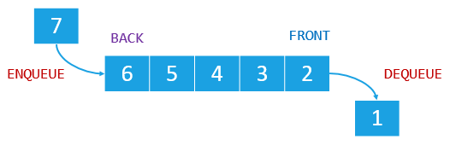
Data Structures
Data structures are representations of data in the computer memory, which allow efficient access and modification
Linear data types: arrays, lists, stacks, queues
0
1
2
3
4
…
…
…
…
…
Array / list (indexed group of elements)
Linked list (sequence of linked elements)
Queue
Notes:
Data structures are representations of data in the computer memory, which allow efficient access and modification.
This is a pretty big topic.
Hundreds of books are written about data structures.
Data structures can be linear structures (such as arrays and lists), tree-like structures (such as balanced trees), graph-like structures (such as graphs), hash-based structures (such as hash-tables) and others.
Linear data types are the most commonly used data structures in programming.
They represent sequences of elements, which can be ordered or not, indexed or not, linked to the next element or not, etc.
Examples of linear data structures are arrays, lists, stacks and queues.
This is how arrays and array-based lists look like in most programming languages and platforms:
They are sequences of elements, which are directly accessible by their position (which is called "index").
This is an example of linked-list.
It consists of elements, where each element knows its next element.
The last element has "null" (or missing value) as next element.
Unlike array-based lists, linked list do not provide direct access by index.
This is an example of array-based queue.
The "queue" data structure works on the principle FIFO (first-in first-out).
Elements are appended in the queue at its left end (at its back). This operation is called "enqueue".
Elements are taken from the queue from its right end (from its front). This operation is called "dequeue".
We shall master the linear data structures in detail in the advanced programming modules at SoftUni.

Slide 28
List of Numbers – Example
List of numbers, representing a sequence of income amounts:
Adding a new income:
Modifying an existing income:
var incomes = [
150, 200, 70.50, 120
];
Element | Value
incomes[0] | 150
incomes[1] | 200
incomes[2] | 70.50
incomes[3] | 120
250
incomes.push(300);
incomes[4] | 300
incomes[1] = 250;
28
Notes:
This is a simple example, which illustrates the "list" data structure.
We have a list of numbers, representing a sequence of income amounts.
This is how the list looks like in the memory.
It is an indexed structure: each element has a unique index, a number in the range from 0 to the size of the list minus one.
This is how we can append a new income.
This is how we can modify an existing income, by its index.

Slide 29
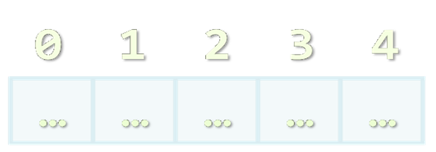
List of Numbers
Live Demo
https://repl.it/@nakov/list-example-js
Notes:
This live demonstration illustrates how to use simple lists in JavaScript.
We open the live example at repl.it.
And we wait for it to load. It needs some time.
This is the same example from the previous slide.
We run it and we see the result: the list before and after the modifications.

Slide 30
Data Structures and Algorithms
Trees and tree-like data structures
Each node holds data + list of child nodes + parent node
Tree traversal algorithms
Depth-First Search (DFS)
Breadth-First Search (BFS)
C:\
DepthFirstSearch(node) {
print(node);
for each ch in node.childNodes
DepthFirstSearch(ch)
}
Programs
Users
Windows
Maria
Peter
George
Notes:
In programming, sometimes we use more complex data structures, like trees.
Tees and tree-like data structures consist of nodes, where
each node holds data + list of child nodes + parent node
This example illustrates visually a tree.
This is a tree holding, the directory structure of a hard drive in Windows.
The root node "C colon backslash" has 3 child nodes: "Programs", "Users" and "Windows"
The child node "Users" has 3 child nodes: "Maria", "Peter" and "George".
The other nodes have no children.
Each node, except the root, have a parent node.
Data structures often come with algorithms for their processing.
Such algorithms can be different styles of traversing;
appending, inserting, deleting and modifying a node;
extracting sub-structures, finding paths, and much more.
Examples of algorithms are the classical tree traversal algorithms:
Depth-First Search (DFS)
And Breadth-First Search (BFS)
We shall learn them in the "Data Structures and Algorithms" module at SoftUni.
This is a sample pseudocode implementation of the Depth-First-Search algorithm.
The in-depth traversal starts from certain node.
Then this node is first printed.
Then the traversal starts recursively from each child node of the current node.
The traversal process initially starts from the root node of the tree and reaches all tree nodes sooner or later.
Unless the tree has a cycle or the tree is not connected, this process in finite and will traverse all the nodes.

Slide 31
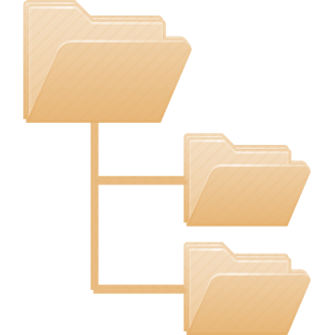
Recursive Traversal of the File System
Live Demo
https://repl.it/@nakov/traverse-folders-cs
Notes:
This live example illustrates the tree traversal algorithm "Depth-First-Search" (DFS), used to traverse the local file system.
Let' see it in action.
We open the live code example at repl.it.
Now we wait for it to load, as usually.
We can see the source code of the example.
Тhe code is a little bit longer and a little more complicated than in the previous example,
but essentially this is the DFS algorithm implemented in C#.
This sample code starts the directory tree traversal
from the parent of the current folder
and traverses recursively the file system under this folder.
Let's run the program.
The output holds all the files and subfolders of the current folder at the server-side, listed recursively.
In this lesson I cannot teach you how to traverse trees.
Instead I can demonstrate important development concepts,
such as data structures and algorithms.
This is just a small example of how an algorithm may look like.
I hope you find it interesting to learn more about data structures and algorithms
later in your learning track for programmers.

Slide 32

Component-Based Software Development
Component-based software development
A programming paradigm in which applications are composed of re-usable components
Components are self-contained pieces of functionality
E.g. PDF generator, email sender, date picker UI control
User interface (UI) components are also known as UI controls, visual components or widgets
Components are distributed in libraries
E.g. the UI control library jQuery UI
Notes:
Component-based software development is software development approach, a programming paradigm, based on the composition of re-usable components.
Instead of building the application or system from scratch, developers take ready-to-use components and plug them into their software.
The components are building blocks, which come from component libraries and software packages (which can be open-source, royalty free or commercial).
Components are self-contained pieces of functionality, ready to be inserted as part of larger software application.
For example, a PDF generator component can be used to
create PDF reports, insert formatted text, images, tables and other elements in them
and then create a PDF file, which can be displayed in the Web browser or printed on paper.
The internal details about the PDF document format and how it works are hidden in the component.
Developers do not need to care about these technical details. They just use the component.
Another example of software component is an email sender, which can send emails, holding formatted text and attachments.
The email components knows how to connect to the specified email server using the SMTP protocol
and how to compose email messages using the MIME standard.
This functionality is encapsulated internally inside the component and developers do not have to go into great technical details.
Another example of software component is a "date picker" UI control, used in Web front-end applications.
The "date picker" visual component is a drop-down box, which shows the calendar and users can select a specific date.
If you open a website to book online airline tickets, you will see such a "date picker" component.
User interface (UI) components are also known as UI controls, visual components or widgets.
Software components can be visual, such as the date picker and non-visual, such as the PDF generator.
Visual components are also called "UI controls".
Software components are distributed in component libraries.
Components libraries are software components, bundled as redistributable software packages.
They can be downloaded from a software component repository (such as npm, NuGet and PyPI).
Or can be purchased from software component publishers (such as Telerik, DevExpress, Aspose, and others).
Or can be publicly available open-source projects (such as Apache Commons Crypto and jQuery UI).
Example of open-source UI control library is the jQuery UI project.
jQuery UI provides front-end user-interface components, widgets, effects and interactions for JavaScript developers.

Slide 33
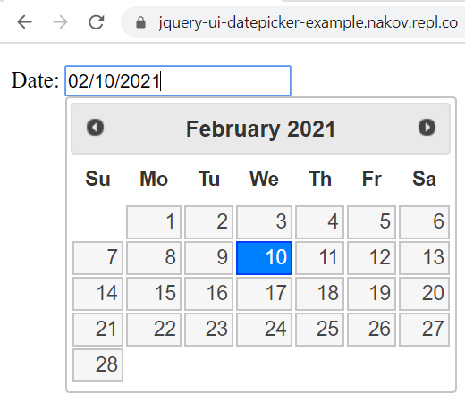
Example of Software Component
UI component "date picker"
Notes:
This is an example of software component (without any technical details).
This is what the end users sees at the screen.
This is how a "date picker" UI control can look like.
When you click the date field, the calendar appears to help you selecting a date.
This is the "date picker" component from the jQuery UI control library.

Slide 34
jQuery UI Date Picker – Example
<script src="https://code.jquery.com/jquery-1.12.4.js"></script>
<script src="https://code.jquery.com/ui/1.12.1/jquery-ui.js"></script>
<link rel="stylesheet" href="https://code.jquery.com/ui/1.12.1/themes/base/jquery-ui.css">
Date: <input type="text" id="datepicker">
<script>
$(() => $("#datepicker").datepicker());
</script>

Slide 35
jQuery UI Date Picker
Live Demo
https://repl.it/@nakov/jquery-ui-datepicker-example
Notes:
This live demonstration illustrates how to use software components.
It demonstrates the "date picker" widget from the jQuery UI control library.
We open the live example at repl.it.
And we wait for it to load. It needs some time.
We run it and we see the date selection box on the right.
And we can choose a date from the calendar.

Slide 36
Event-Driven Programming
Event-driven programming
A programming paradigm in which the flow of the program is determined by events, e.g. mouse clicks, key presses, etc.
Event source (event emitter)
Produces events, e.g. when the mouse is clicked
Event handler (event consumer, callback)
Processes events, e.g. show a message
Notes:
Event-driven programming is a programming paradigm,
in which the flow of the program is determined by events,
such as mouse clicks, key presses, button clicks, and many others.
Typically a software framework drives the application
and listens for events in an event loop,
and when an event occurs, the framework calls the code to handle it.
Developers write the code for handling the events (functions or methods).
Examples of event-driven software frameworks are:
The user interface (UI) system in the Web browsers, where the HTML5 standard describes the components and their events.
Another example is the UI system in Android, which defines a set of UI components with events.
Event source (or event emitter) is a software component, that produces events.
For example, an internal component in the software framework may track the mouse
and when the mouse is clicked, it may emit an event.
Typical example of event source is the "button" component, which defines the "on click" event.
Developers can write their own components (such as an "email sender") and emit events in certain situations,
for example, when a successful connection to the mail server is established,
or when the email was rejected by the server for some reason.
Event handler (or event consumer) is a piece of code (or callback function), written by developers, to handle (or process) an event.
A simple example is to show a message, when a button is clicked.
In this example the button is an event emitter.
It has "on click" event, which can be handled by developers.
To handle the event, developers write an event handling function and assign it for the "on click" event.
When the button is clicked the framework emits the "on click" event.
The event handling function handles the "on click" event and shows a message.

Slide 37
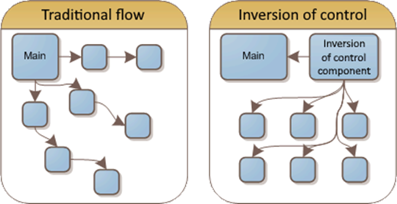
Inversion of Control (IoC)
Inversion of control (IoC) principle
A function / component / framework does the processing and calls pieces of your code for certain tasks
Examples of IoC behavior:
A parser processes a document and calls events when it finds certain tokens
A GUI app manages the UI and calls events for the user input
Notes:
The inversion of control (IoC) principle is a program control-flow paradigm, where
a function or component or framework does the processing and calls pieces of your code for certain tasks.
The control is inverted:
Instead of your program to keep the control and invoke external functions and libraries,
the framework takes the control and invokes pieces of your program's code (functions from your code).
This concept is called "inversion of control" and is very often used with software frameworks.
For example, most user interface (UI) frameworks work under the "inversion of control" principle:
The UI frameworks typically keeps the control and the execution of your entire application,
and invoke your code to handle events, to which your code is subscribed.
Look at the pictures at the screen to get a better understanding of the
difference between the "traditional program flow" and the "inversion of control" program flow.
Let's look at two examples of "inversion of control" behavior, to understand it better:
The first example is a parser, which processes a document and calls events when it finds certain tokens.
For example, an XML parser takes as input an XML document,
and it calls an event handler from your code, when a new tag is found in the XML document.
This is how event-driven XML parsers work, such as SAX.
SAX stands for "Simple API for XML" and is widely used industry standard for XML processing.
Another example is a GUI app: a visual app with a graphical user interface (GUI)
The UI framework drives the app and keeps the control over its execution.
The framework manages the UI, draws the UI controls, listens for user interactions and emits events after each interaction.
When the text is changed in a text box, or a button is clicked or the focus is moved from one text field to another, the UI framework emits an event.
Developers handle these events by providing event-handler functions and respond to user interactions.
Most user interface frameworks and libraries are event-driven and use the "inversion of control" principle.
That's why "event-driven programming" and "inversion of control" are so important.
If you deal with front-end and user interfaces, you will use inversion of control frameworks and event-driven programming.
We shall learn how to create front-end applications in the professional modules and courses at SoftUni.

Slide 38
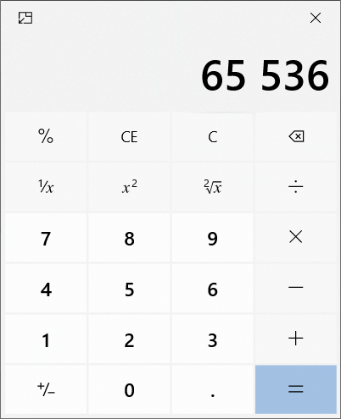
Example of IoC and Event-Driven Programming
The UI framework draws the UI and check for events in a loop (event loop)
Clicking a button emits an event, which is handled by the calculator's engine
Notes:
This classical "calculator" app is a good example of component-based app, which
relies on the "inversion of control" and "event-driven programming" concepts.
The UI framework draws the user interface of the app and infinitely check for user input in a loop.
The infinite loop in the UI framework, which tracks the user input and other events, is called an "event loop".
Clicking a button from the "calculator" app emits an event "on click".
This event is handled by the calculator's engine and its program logic decides what to calculate and print at the calculator's screen.
The "calculator" app gives the control to the UI framework and handles events emited from it.
Most computer games also work this way:
The game engine (the framework for game development) draws the game objects at the screen and processes their movements and interactions.
When something interesting happens in the game, such as when two objects collide, the game engine invokes an event handler to decide what to do.
This is again "inversion of control" program flow and "event-driven programming".

Slide 39
Event-Driven Programming – Example
function analyzeString(text, onLetter, onNewWord) {
let newWord = true;
for (const letter of text) {
if (letter.match(/\w/i)) {
if (newWord)
onNewWord();
onLetter(letter);
newWord = false;
} else
newWord = true;
}
}
Scan through the text, extract letters and detect where a new word starts
Emit an event
Event-driven processing with inversion of control
Emit an event

Slide 40
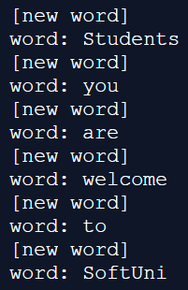
Event-Driven Programming – Example (2)
Execute an inversion of control processing
let word = '';
analyzeString(
"Students, you are welcome to SoftUni!",
function onLetter(l) { word += l },
function onNewWord(l) {
if (word != '')
console.log('word:', word);
console.log('[new word]');
word = '';
}
);
console.log('word:', word);
Event handler
Event handler

Slide 41
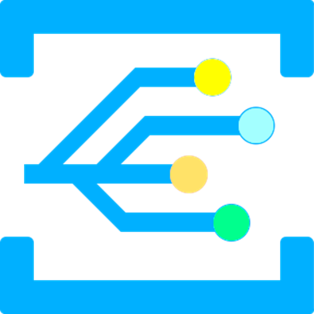
Event-Driven Programming
Live Demo
https://repl.it/@nakov/event-driven-example-js

Slide 42
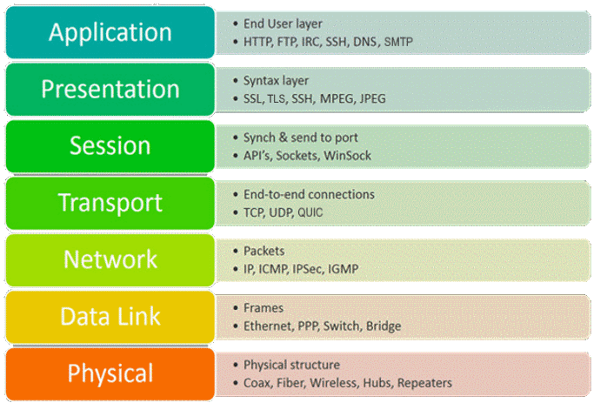
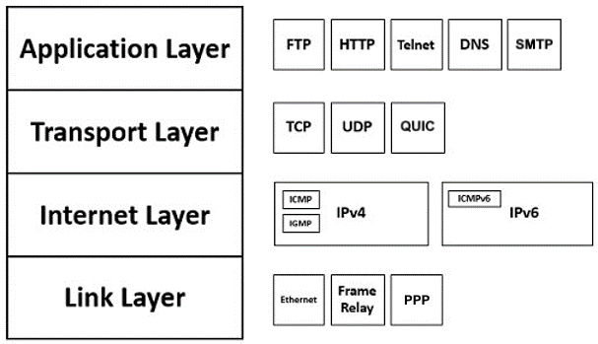
Networking and Internet Protocols
Communication in Internet uses networking protocols
The OSI model defines 7 layers of networking protocols
The TCP/IP protocol suite
Notes:
Networking and Internet protocols play an important role in software development.
Communication in Internet uses networking protocols.
Protocols define the technical standards for communication between two systems, for example a mobile app and a Web server.
The OSI model defines 7 layers of networking protocols.
OSI stands for "Open Systems Interconnection" and defines a framework on which modern networking and communication standards are based.
The 7 layers of the OSI model are:
Layer 1: the Physical layer.
It is responsible for the physical connection between two or more parties.
At the physical layer, the data is carried by electrical impulses (using electrical cables), radio signals (in wireless communication), or light (using optical cables).
The physical layer specifications define characteristics such as voltage levels, the timing of voltage changes, physical data rates, maximum transmission distances, modulation scheme, channel access method, physical connectors and many more.
The physical layer is part of the specifications of the USB, Bluetooth, Ethernet and WiFi standards.
Repeaters, hubs and antennas are typical devices at the physical layer.
Layer 2: the Data Link layer.
It provides node-to-node data transfer – a link between two directly connected nodes in the same network.
The data transferred is split into packets called "frames".
Layer 2 hardware, such as Ethernet adapters and modems are responsible for transmitting the frames over the physical connections.
At layers 2 communication devices are identified by hardware addresses, such as MAC address.
Typical data link layer protocols are Ethernet and PPP.
Network switches are typical hardware for the layer 2 (the data link layer).
Layer 3: the Network layer.
Layer 3 networking protocols (such as IP, IPv6, IPSec, ICMP and IGMP) transfer packets (such as IP packets) between two nodes at two different networks.
Packets typically pass through several routers to reach their destination.
The routing of the packets is an important concept for the layer 3 networking.
Routers are typical hardware for the layer 3 (the network layer).
The concept of "IP address" comes from the layer 3 and is important for software developers.
Layer 4: the Transport layer.
The transport layer protocols (such as TCP, UDP and QUIC) are responsible for end-to-end communication between the two endpoints.
These protocols transfer data, split into pieces called "segments", and handle the flow control and error control during the communication.
For example, if an IP packet at layer 3 is lost, it will not be retransmitted and it will never arrive,
but layer 4 protocol TCP retransmit the lost TCP segments and maintain streams of data between the endpoints.
An important concept from the developer's perspective at layer 4 is the port number.
Port numbers allow maintaining multiple parallel stream connections between two endpoints.
Layer 5: the Session layer.
It controls the dialogues (connections) between computers.
It establishes, manages and terminates connections between the local and remote application.
Example protocols at layer 5 are RPC (Remote Procedure Call) and virtual private networking protocols like PPTP.
Layer 6: the Presentation layer.
It is responsible for translation, encryption, and compression of data.
Example protocols at layer 5 are SSL (Secure Socket Layer) and TLS (Transport Layer Security).
Layer 7: the Application layer.
This is the only layer that directly interacts with data from the user.
Software applications like Web browsers and Email clients rely directly on the application layer protocols.
The "Application layer" is the most important for software engineers from all the OSI layers,
because the code developers write, directly interacts at this layer.
Typical application level protocols are: HTTP, SMTP, POP3, IMAP, FTP, DNS and many others.
The HTTP protocol connects Web clients with the Web servers and allows downloading resources from the Web.
The SMTP, POP3 and IMAP protocols are used by email clients to send and read emails.
Many other protocols operate at the application layer and you will encounter some of them in your career as a software engineer.
The 7-layer OSI model is too complicated.
It is designed for network engineers and communication experts.
In software development a simplified networking model exists.
It is called "The TCP/IP protocol suite" and it consists of only 4 layers:
Link layer, which combines physical media and data link protocols, such as Ethernet.
Internet layer, which transmits packets between two hosts in Internet, using the network protocols IP or IPv6.
Transport layer, which provides communication between two endpoints, using the TCP, UDP or QUIC protocols.
Application layer, which defines how two applications (client and server) talk to each other. Protocols like HTTP, HTTPS, SMTP, SMTPS, DNS and DNSSEC operate at the application level.
Network protocols are a large area of knowledge and it takes years to master them in detail.
Software engineers only need to learn the basic concepts of networking, networking models and the basics of the most important network protocols (like HTTP).
Everything else from the world of networks is optional and whether developers need it highly depends on their narrow specialization.

Slide 43

HTTP and Socket Communication
Most applications communicate through HTTP or sockets
HTTP is "request / response" based protocol for the Web
Clients request resources (GET / POST / PUT / DELETE request)
The Web server provides the resource (HTTP response)
Sockets are bidirectional communication streams
Web sockets are sockets that run over HTTP
Allow JavaScript client to communicate with the Web server bidirectionally
Notes:
Most connected applications communicate through HTTP or sockets.
HTTP is application level protocol for the Web,
the protocol used by Web browsers to open Web sites.
Sockets are bi-directional stream connections,
usually implemented by the TCP protocol or the WebSocket protocol.
which is a socket over HTTP.
HTTP is a "request / response" based protocol for the Web.
Web clients request a resource, using HTTP GET, POST, PUT or DELETE request.
The Web server responds to the request and provides the resource as HTTP response.
We already had a lesson about HTTP in this course at SoftUni, so I will not discuss HTTP in detail.
Sockets are bidirectional communication streams.
When a socket connection is established between two endpoints (host + port),
both participants can send and receive data, which arrives in the same order, as it was sent.
Sockets are used for communication over Internet.
Sockets are used to open a Web site, to download a file from Internet, for real-time communication such as chat messaging, for streaming video, for gaming and in many other scenarios.
HTTP also works over a TCP or QUIC socket connection.
Web sockets are sockets that run over HTTP.
If supported by the Web server, an HTTP connection can be upgraded to a WebSocket, using special HTTP Upgrade headers in the request.
Web sockets allows JavaScript clients to communicate with the Web server bidirectionally in a message-oriented style.
The Web server can push data messages to the client over the Web socket at any time.
The Web client can also push data messages to the Web server over the Web socket at any time.
The WebSocket technology allows Web applications to efficiently communicate in real-time.
You will learn more about socket communication later at SoftUni, in the Web development professional modules.

Slide 44
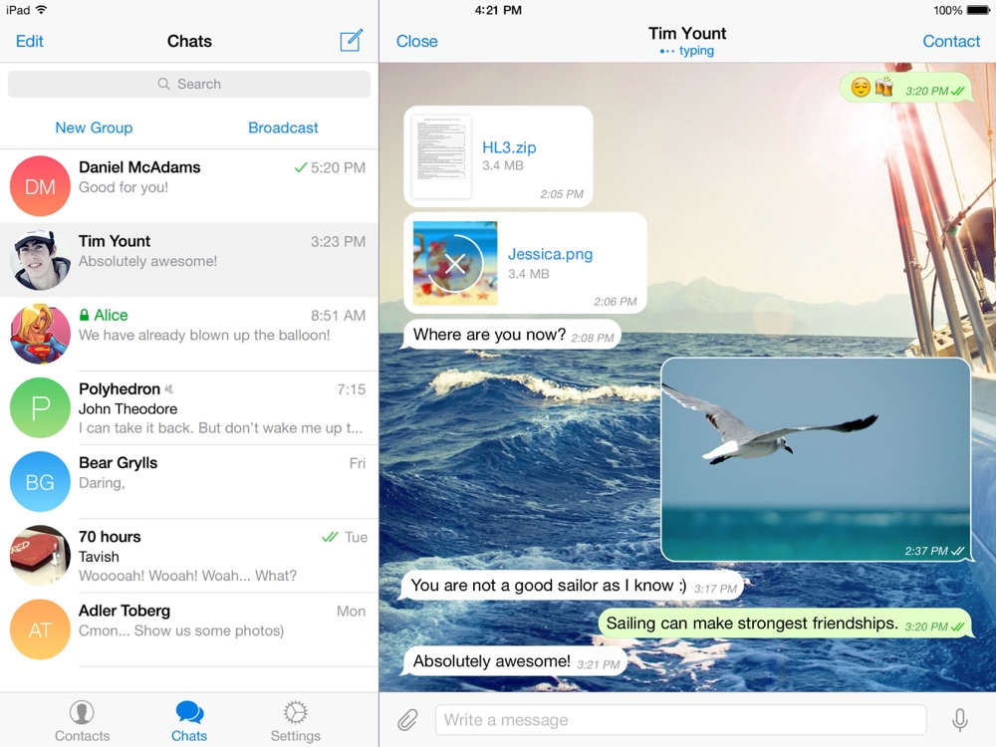

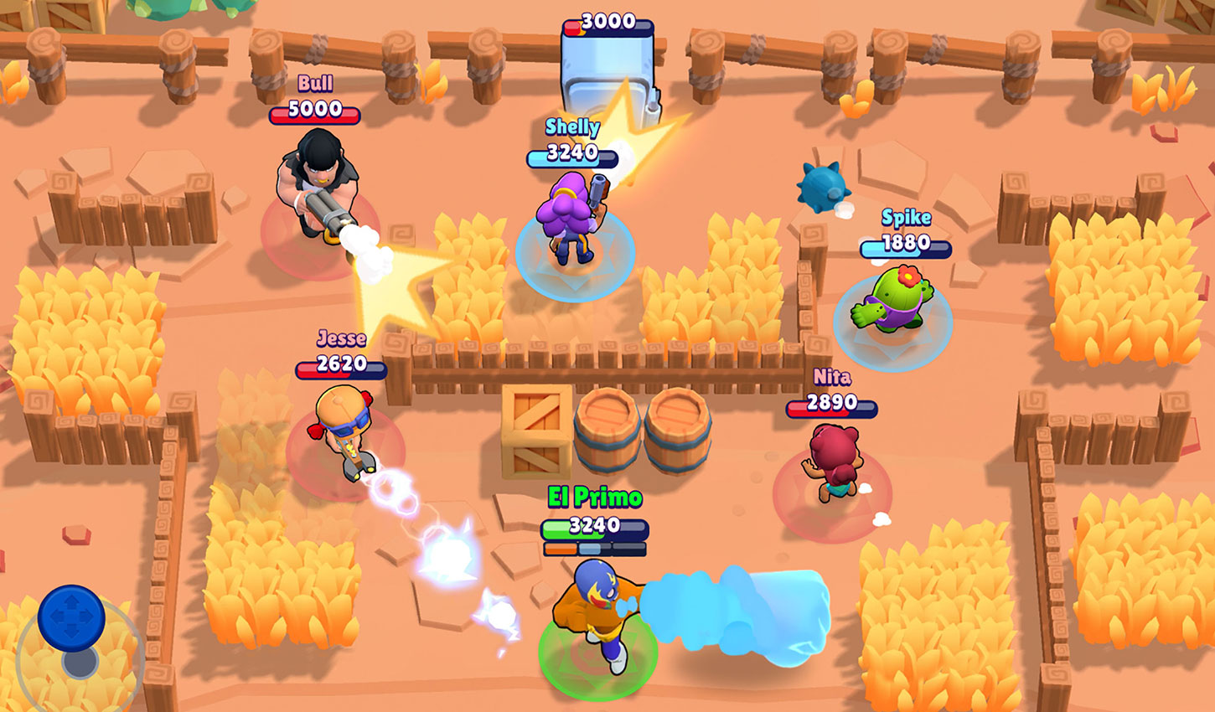
Real-World Example of Socket Communication
Telegram Messenger
The "Brawl Stars" Game
The Live Crypto Prices Dashboard @ Investing.com
Notes:
To get an idea where socket-based Internet communication is used, I will give you a few examples:
The first example is the well-known Telegram Messenger.
It uses WebSockets to send and receive messages from the Telegram servers.
The Messenger client maintains a socket connection with the server.
Using the socket connection, the server pushes new messages to the client.
The client can also send messages to the server.
Telegram clients can connect through classical TCP socket, through a Web socket or using HTTP long polling (when sockets are unavailable).
The second example is the famous game "Brawl Stars".
When you play Brawl Stars through the network,
the Brawl Stars game client communicates with the Supercell game server
over a TCP socket on port 9339.
The third example is the live crypto prices dashboard @ Investing.com.
You can open the real-time crypto dashboard from https://investing.com/crypto/.
This Web site shows the real-time prices of the most popular cryptocurrencies, such as Bitcoin, Ethereum and Ripple.
This Web site connects to the Web server using a WebSocket.
After connecting, the server pushes constantly the price changes to the client.
We can watch this communication using "Chrome DevTool".
We press [F12], open the [Network] tab, then we find the "websocket" request and click on the [Messages] tab.
Messages with price updates come constantly from the server.

Slide 45
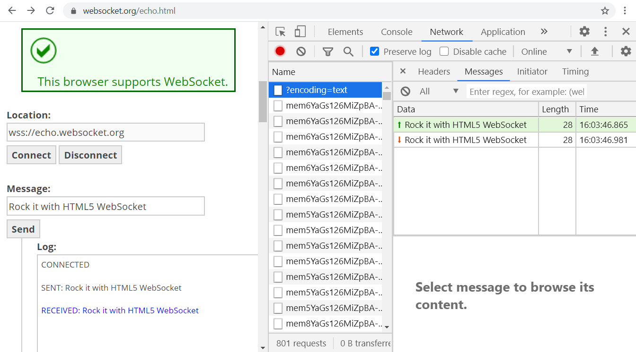
Example of Web Socket Communication
Notes:
Another example of WebSocket, from the developer perspective, is the site:
https://websocket.org/echo.html
It is a simple WebSocket client, which can connect to a WebSocket server and send and receive messages from it.
We can play with it.
We click the [Connect] button and we connect to echo.websocket.org.
Now we send a message using the [Send] button.
The log shows the messages sent to the server and received from the server.
The server replies with the same message, that we sent to it.
Now let's see the messages in the network inspector in Chrome Dev Tools.
Click [F12] to show the Network Inspector.
Click [Disconnect] then [Connect].
Click on the WebSocket connection in the list of HTTP requests.
Now click the [Send] button several times and see the messages that go though the Web socket.
This is how Web sockets work.
First, the client connects to the server.
Then the client and the server talk to each other by sending messages.
WebSocket is bi-directional message-oriented communication protocol for the Web.

Slide 46
The WebSocket API in HTML5: Server
The WebSocket API provides bidirectional socket communication for Web apps, part of the HTML5 standard
Sample code, implementing a WebSocket server:
const WebSocket = require('ws');
const wsServer = new WebSocket.Server({ port: 8080 });
wsServer.on('connection', function(ws) {
ws.on('message', function(msg) {
ws.send('You said: ' + msg);
});
ws.send('WSS Echo Server: Welcome!');
});

Slide 47
The WebSocket API in HTML5: Client
Sample code, implementing a WebSocket client:
let ws = new WebSocket("wss://websocket-server-js.nakov.repl.co");
ws.onopen = e => {
document.write("<p>Connected.</p>");
ws.send("Hello");
}
ws.onmessage = e =>
document.write("<p>Received: <i>" + e.data + "</i></p>");
ws.onclose = e => document.write("<p>Disconnected.</p>");
ws.onerror = e => document.write("<p>Error: " + e + "</p>");

Slide 48
WebSocket
Live Demo
https://www.websocket.org/echo.html
https://repl.it/@nakov/websocket-server-js
https://repl.it/@nakov/websocket-client-js
Notes:
For the most curious of you I have prepared another live example:
A web socket server and a Web socket client for it, which connect to each other and exchange messages.
First, open the server link at repl.it.
Wait a bit for the code to load.
This is a JavaScript code, implementing a Web socket server in Node.js.
We run it. It will start and then will be waiting for client connections.
Now, open the client link at repl.it.
It needs some time to load.
It's a simple HTML page with JavaScript code, which interacts with our Web socket server.
This is the Web socket client application.
We run it.
On the right we can see the messages exchanged between the client and the server.
Every 3 seconds, the server sends the current time to the client as a text message.
I will skip explaining the code of the Web socket client and the server, because now we want to learn concepts, not technologies.
The concept here is the socket communication, which allows the client and the server to send messages to each other.

Slide 49
Asynchronous Programming
Asynchronous programming and concurrent execution allow multiple pieces of code to run simultaneously
Multithreading in Java and C# (several threads run concurrently)
Accessing common data from concurrent threads may need synchronization (mutexes, semaphores, atomic operations)
Background tasks (C#) and promises (JS) with async / await
Web Workers and Service Workers in HTML5
Multiple parallel processes in Windows / Linux
Notes:
Asynchronous programming is another important paradigm in software engineering.
Asynchronous programming and concurrent execution allow multiple pieces of code to run simultaneously.
This is quite natural in computer software: you can listen to music on your laptop while browsing a website and downloading files.
Asynchronous programming allows several functions or methods of your code to be executed simultaneously,
just like you are executing several programs in the same time.
There are many concepts and technologies, which implement asynchronous code execution:
multithreading, background tasks, promises, forked processes, web workers, service workers, and others.
Multithreading in Java, C# and Python allows simultaneously running several threads.
A thread of execution is a piece of code, which runs simultaneously within your program or application.
Threads are methods or functions, which are executed concurrently.
A program can run multiple threads concurrently.
Threads share the program state, memory and other resources.
Accessing shared data from concurrent threads may need synchronization.
What will happen if one thread is printing the elements from a list, while another thread is deleting some of the elements in the same time?
Тhe program can crash, when it tries to read deleted elements.
This is a big problem with multithreaded applications.
Inconsistent behavior, crashes, unexpected results, and hanging are just few examples of problems when multiple threads access shared data concurrently.
To solve these challenges, developers use "thread synchronization".
Critical sections, locks, mutexes, semaphores, signals, atomic operations and monitors are examples of synchronization objects used in multithreading to resolve the conflicts when accessing shared data from several threads.
Many programming languages offer a simplified concurrent programming model, without threads.
It is based on background tasks (in C#) and promises (in JavaScript).
Tasks and promises are handled with special language constructs: async and await.
We shall learn how to use them in the JavaScript programming modules and courses at SoftUni.
Web Workers and Service Workers in HTML5 are tasks (JavaScript code), which run in the background.
Workers are like threads, but they cannot access shared data, so synchronization is not needed.
Workers communicate with the hosting Web site through messages.
Running multiple parallel processes in Windows or Linux is another option to implement concurrent code execution.
This approach is typical for lower-level programming languages like C.

Slide 50
Web Worker – Example
web-worker-example.html
worker.js
<!DOCTYPE html>
<html>
<script>
let w1 = new Worker('worker.js');
w1.onmessage = e => document.write(
"<p>Worker #1 received: <i>" +
e.data + "</i></p>");
let w2 = new Worker('worker.js');
w2.onmessage = e => document.write(
"<p>Worker #2 received: <i>" +
e.data + "</i></p>");
</script>
</html>
let counter = 0;
setInterval(() => {
postMessage(++counter);
}, 1000);

Slide 51

Concurrent Execution using Web Workers
Live Demo
https://repl.it/@nakov/webworker-js
Notes:
In this live example, I will demonstrate how to implement concurrent code execution using Web Workers in JavaScript.
We open the live example at repl.it.
It needs some time to load, as usually.
We have an HTML file, which starts 2 Web workers,
and JavaScript file, which holds the Web worker's code.
We run the example and we see the execution results.
The HTML page starts two Web Workers,
which run in the background simultaneously.
Once per second each worker sends a message to the page:
an increasing integer number.
The Web page prints the data received from the background workers.
And this is the output.
The most curious of you could take a closer look at the code to learn how it works.

Slide 52
Promises
A promise in JS holds an operation that runs asynchronously
After completion or failure an event is called
let request = fetch('https://blog.softuni.org/wp-json/wp/v2/posts');
request.then(function(response) {
response.json().then(function(posts) {
console.log(JSON.stringify(posts));
});
});
request.catch((err) => console.log(err));
Notes:
Promises are very important concept in JavaScript and some other languages.
You cannot be a JavaScript developer without understanding how to use promises.
Without promises, you cannot execute asynchronous tasks like downloading a resource from the server.
A promise in JS holds an operation that runs asynchronously.
After completion or failure an event is called.
This means that the operation behind a promise runs in the background.
Some functions (like fetching a resource) do not return the result but return a promise.
This is a promise to execute the requested operation in background and return the result later.
Promises accept functions to be invoked in case of success and in case of error.
Let's see an example.
We fetch the blog posts from the SoftUni blog, through its API.
This "fetch" function in JavaScript downloads a resource through an asynchronous HTTP request.
It does not return the resource itself, but instead returns a promise.
Next, we pass to the promise a function to be called in case of success.
This function will receive the HTTP response as parameter from the promise.
To download the response body as JSON object, we use a promise again.
In case of success, we print the downloaded blog posts as JSON string on the console.
Finally, we pass to the promise a function to be called in case of error (a lambda expression).
This function will be invoked in case of problem,
for example if the remote server is down,
or if the specified URL is invalid,
or if the Internet connection is lost.
The error function will receive the error details as parameter from the promise.
If an error occurs, we print the error details on the console.

Slide 53

Fetching Resources Asynchronously
Live Demo
https://repl.it/@nakov/fetch-example-js
Notes:
Let's see the previous example in action.
We open the live example at repl.it.
It needs some time to load, as usually.
We run the example and we see the blog posts from the SoftUni blog.
This code first prints the JSON received from the Web server as it is.
Then it extracts the post ids and titles from the JSON and prints them.
We can modify the code to request an invalid URL to see what will happen.
We change "/posts" to "/posts2". Now the URL is invalid.
We run the code and we see an error: 404 Not Found.
The promise has failed to download the resource and the error handler has been invoked.

Slide 54
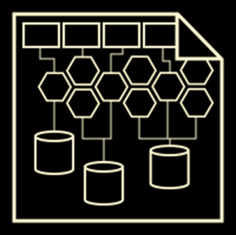
Software Architectures
Notes:
Software systems are structured as set of interconnected components.
This structure is called software architecture.
Let's review the main principles behind the software architectures:
from the monolith apps to the client-server model and the 3-tier and multi-tier architectures.
Let's also explain two popular concept from software development: front-end and back-end.

Slide 55
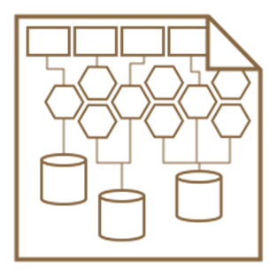
Software Architectures
Software systems consist of interconnected components organized in certain structure called architecture
Concepts related to software architectures:
Monolith apps
Client-server model
Front-end and back-end
3-tier and multi-tier architecture
SOA and microservices
Notes:
Software systems consist of interconnected components organized in certain structure called architecture.
Software architecture is a broad engineering discipline.
In large organizations the architecture is designed by the software architects.
In smaller organizations, the architecture is designed by the senior developers or by the technical team leader.
The software architecture defines the structure of the system: its components and their interactions.
Concepts related to software architectures are:
Monolith apps – applications, consisting of a single component
The "client-server" model, where the client requests resources from the server and displays them to the user
The concept of "front-end" (the user interface of the system) and "back-end" (the data storage and processing logic)
The classical "3-tier" and "multi-tier" architectural models, where the system is split into user interface, business logic and data storage
The concept of "SOA" (service-oriented architecture) and microservices (self-contained software components)
All these concepts are complicated, and developers learn them in detail as they gain experience for many years.
At SoftUni we shall review only some of these concepts, because junior developers should be familiar with them.

Slide 56
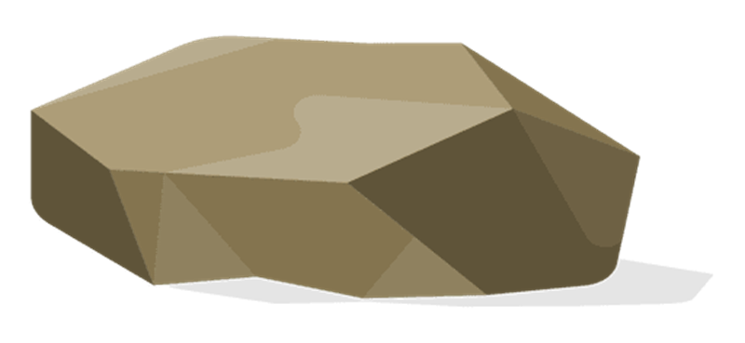
Monolith Apps
Monolith apps
A single application holds its data, logic and user interface (UI)
Single user (no shared data access)
Disconnected from Internet
App data is stored on the local machine
Examples:
A simple smartphone game
The Notepad text editor
Notes:
Monolith apps are the simplest software architecture.
Monolith app architecture means that a single application holds all its data, logic and user interface (UI).
Monolith apps are typically designed for a single user.
They don't expose shared data, which can be accessed by many users.
Some monolith apps may be used by several users, but not in the same time.
Monolith apps are disconnected from Internet.
They operate on the local machine, without storing any data outside of the app.
As an exception, they can sometimes read data from Internet, but they don't store anything outside of the app.
The application data in the monolith app architecture is stored on the local machine.
Not on any server on the Internet.
Examples of apps that are developed under the monolith app architecture:
A simple smartphone game:
You install the game and play it on your mobile phone or laptop without accessing the Internet.
You play alone, without any interaction with other players over the network.
The Notepad text editor is another monolith app example:
You open local files, edit them and save them.
There is no interaction with other users, no shared data, no communication over the network.

Slide 57

The "Client-Server" Model
The client-server architectural model
The server holds app data and logic and provides APIs to clients
The clients implement the UI (the user interface) and consume the server APIs
Examples:
Web browser ↔ Web site
Email client ↔ Email server
Chat client ↔ Chat server
Notes:
The client-server architectural model is widely used in modern apps.
Web sites, games, information systems, business software are just few examples of client-server systems.
Unless the architecture is more complex,
if an app is connected to the Internet and stores data at some server,
it is built on a "client-server" architecture.
In the "client-server" architectural model,
the server holds the app data and the business logic
and provides APIs to clients to access the server data.
The clients implement the user interface (the UI) and consume the server APIs.
This is how most modern apps like Facebook and YouTube work:
The server holds the app data, such as users, chat messages, photos, videos, etc.
The client (such as mobile app or Web app) displays the data, stored at the server.
The server is responsible for data storage and data processing.
It holds the business logic: who can access the data, which data, who can store new data, etc.
The server exposes an API (application programming interface), typically accessible over HTTP, and clients call this API.
The client is responsible for the user interface: to read the data from the server and display it to the user.
Clients access the server through the Internet or through a local network.
The data in the client-server model is shared.
This means that several users can work on the same data in the same time.
The server usually implements mechanism to resolve the eventual conflicts when several users change the same data.
Let's look at these few examples of client-server systems:
The first example is when a Web browser opens a Web site.
The Web browser is the client software.
The Web server, holding the Web site, is the server software.
The app data stored at the server-side is the Web site itself.
The user interface at the client side is the rendered Web page from the Web site.
The second example is when an Email client retrieves the email messages from a mail server.
The email client is the client software. It retrieves and email messages from the server and displays them.
The mail server, holding the users' mailboxes, is the server software.
The app data stored at the server-side are the mailboxes with the mail messages for each user.
The user interface at the client side is the email app (mobile, desktop or Web app).
The third example is when a chat client communicates with a chat server to display the most recent chat messages for certain user.
The chat client is the client software. It listens for new messages and displays the chat conversations for the current user.
The chat server, holding the users and their chat conversations, is the server software.
The app data stored at the server-side are the users and their chat conversations, photos, videos, documents, files, etc.
The user interface at the client side is the chat app (mobile, desktop or Web app).
The client-server model is almost everywhere, when we have connected applications.
It is an important concept in software development and programmers should understand is well.
At SoftUni, we teach the client-server model in many courses in the professional modules related to front-end and back-end development.

Slide 58





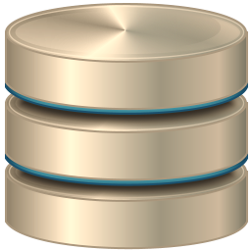

3-Tier Architecture / Multi Tier Architecture
Presentation tier
Business logic tier
Data management tier
Client (Web browser)
Web application server (e.g. JBoss)
Database server (e.g. MySQL)
Client (mobile app)
Notes:
The "3-tier architecture" and its extension, the "multi-tier architecture" are architectural models for development of complex software systems.
The 3-tier architecture consists of 3 components (called tiers):
The presentation tier – the user interface.
The business logic tier – where data is processed.
The data management tier – where data is stored.
The 3-tier architecture is used for structuring big and complex enterprise-grade systems.
It allows these 3 tiers to be run as separate components, which simplifies the maintenance and improves the scalability.
In many systems these 3 tiers run on separate hardware and are developed and maintained by different teams of developers.
Let's review what's inside these 3 tiers.
The presentation tier holds the client apps:
Client apps are responsible for the user interface of the system: to display the data to the user and interact with the user.
The client app could be a Web front-end app, running in a Web browser, or a mobile app, or a desktop app.
In all cases it implements the user interface (the front-end) of the system.
The client apps interact with the server-side, using an API, a programming interface, such as RESTful service requests over HTTP.
For example, in a chat app, the client is the app, which displays the contact list and the chat conversations.
The business logic tier is implemented at the server-side.
Typically it runs in an application server, or Web application server or behind a simple Web server.
The business logic is the functionality, which is invoked by the client apps through the API.
It implements the business rules, the core functionality of the application.
It also handles users, authentication and authorization, access control and the business rules.
For example, in a chat app, the business logic tier will provide APIs for:
user login an authentication, retrieving the contacts, retrieving the conversations, sending a message, receiving instant messages, etc.
The business logic implements the core functionality of the chat system.
The data management tier is responsible for data storage.
Typically, it is a database system, such as MySQL, MS SQL Server or PostgreSQL,
or a cloud-based data storage system, such as Amazon S3 or Azure Table storage.
The data management tier does not care about the business rules.
It just stores and retrieves data: objects, table rows, files, documents, images, video and other assets.
Structuring the app into 3 separate subsystems (or tiers) has many benefits for large enterprise systems:
Simplified manageability: different development or IT teams can implement the different tiers.
Improved scalability: the system can be upgraded to use multiple database instances in a cluster, for example, without changing the other tiers.
Improved security: a breach at some of the tiers does not directly affect the other tiers.
Hacked Web server does not mean full access to the entire database.
Improved maintenance: smaller and simpler components are maintained easier.
At the same time, decomposing the system into 3 separate tiers, increases the system complexity and takes more time for the development.
Some more complex systems can be decomposed into more than 3 tiers.
For example: client tier, authentication tier, business logic tier, data access tier, and database tier.
This is called "multi-tier" architecture.

Slide 59
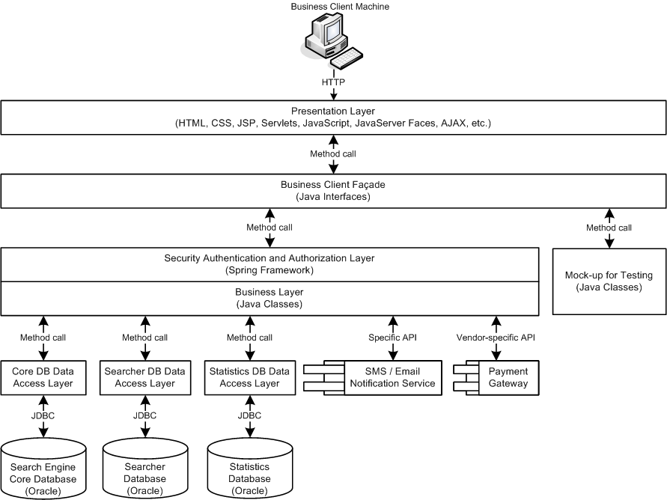
Software Architecture – Example
Notes:
This is an example of software architecture diagram.
It explains how a relatively complex multi-tier system works,
how the client app interacts with the server-side,
the structure of the server-side components,
and their interaction with the database and external APIs.
This is just an example from an old Java-based system,
and the details here are not important.
Important are the concepts:
the software architecture as a way to structure apps.

Slide 60
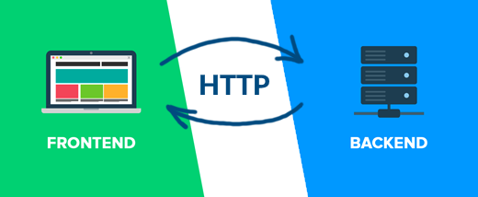
Front-End and Back-End
Front-end and back-end separate the modern apps into client-side (UI) and server-side (data) components
Front-end == client-side components (presentation layer)
Implement the user interface (UI)
Back-end == server-side components (data and business logic APIs)
Implements data storage and processing
HTTP connects front-end with back-end
Notes:
Front-end and back-end are important concepts in software development.
Front-end and back-end separate the modern apps into client-side (user interface) and server-side (data processing) components.
Almost all connected software we use every day has front-end and back-end.
The front-end and back-end come form the "client-server" model and are also part of the more complex software architectures.
Most modern apps are not monolith and have client-side (front-end) and server-side (back-end).
The front-end consists of the client-side app components, the so called "presentation layer".
It displays the presentation to the user, the user interface (UI) of the app.
This is what users see on the screen:
text, images, video, fields, lists, icons, buttons, sliders, toolbars, menus and other UI elements.
The front-end is where users interact with the app.
Clicking icons, pressing buttons, sliding a list up and down, selecting items from a list, entering text in text fields, drawing at the screen, playing and recording audio and video: all this is user interaction, and it happens at the front-end.
The data, collected at the front-end, is typically sent to the server-side for processing.
The front-end only executes simple presentation logic, like data validation.
Data storage and business rules are implemented at the back-end.
Example of front-end is the Facebook client app on your smartphone.
It displays the news feed from your friends and allows you to share links, messages and photos.
All the content is stored at the back-end at the Facebook servers and comes through the network.
To display the news feed, the client app sends a request to the back-end API, retrieves the data and visualizes it at the screen.
The back-end consists of the server-side components of the software systems.
It implements data storage, data processing and business logic.
It is typically structured as services, which expose a set of operations.
These services are accessible externally, typically after some authentication.
The back-end exposes an API for the front-end to access server-side logic and data.
API is the application programming interface: the functions and methods, which are available for the client apps.
The back-end systems often use external storage systems, databases and external APIs to implement data storage.
These data storage systems can be relational databases (like MySQL),
document databases (like MongoDB),
key-value storage systems (like Redis),
cloud databases (like Amazon DynamoDB ana Azure CosmosDB),
file storage systems (like Amazon S3 and Azure Blob Storage)
and many others.
Example of back-end is the Facebook server-side functionality, running at the Facebook server infrastructure.
It keeps the users, their friends, the news feeds, the shared links, messages, photos and all the content and processing logic.
This content is delivered to the front-end apps through the network using an API (programming interface).
When a client app requests the news feed for certain user, the back-end retrieves the data from the database and sends it to the client over the network. This is how it works.
Most software systems use the HTTP protocol to connect the front-end with the back-end.
In this scenario the server-side APIs are exposed as operations, available through the standard HTTP methods:
GET, POST, PUT, PATCH and DELETE.
This is known as "RESTful API" – a set of operations to retrieve and modify data using HTTP.
Alternatives to the RESTful APIs are the:
The GraphQL from Facebook, which is a data retrieval query language,
and FALCOR from Netflix, which implements remote data models based on JSON.
Some systems use different protocols than HTTP to connect the front-end with the back-end.
For example, gRPC is a binary-level protocol from Google for invoking remote functionality, designed for high-performance.
Another example is the ReactiveX communication framework, which is based on the publish-subscribe model and implements observable remote data streams.
Still, the HTTP and REST are the dominant technology for interaction between front-end and back-end.

Slide 61

Front-End Technologies
Front-end technologies
Web front-end: HTML + CSS + JavaScript + JS libraries
Web front-end frameworks: React, Angular, Vue, Flutter
Desktop front-end: XAML (Microsoft), UIKit (Apple)
Mobile front-end: Android UI, SwiftUI
Hybrid mobile front-end: React Native, Ionic
Front-end developers deal with UI, UX and front-end technologies and frameworks
Notes:
Front-end technologies are the software technologies, used to build the front-end (the user interface) of the apps.
Let's mention the most popular of them:
Web front-end is the most important front-end technology in modern software development.
It is based on HTML, CSS, JavaScript and JavaScript libraries and frameworks.
These are the technologies used to build the user interface, displayed in the Web browsers.
Web front-end is used by Web sites, Web applications and browser-based desktop and mobile apps.
Everything you see on the screen when you open a Web page, is built using these Web front-end technologies: HTML + CSS + JavaScript.
We will pay significant attention to the front-end technologies in the professional modules in SoftUni.
The Web front-end frameworks and libraries, such as React, Angular, Vue and Flutter,
extend the basic Web front-end with more complex functionality and features
to simplify and structure the development of user interfaces in a highly maintainable way.
UI frameworks provide large number of pre-built components, rendering engines, data processing concepts, patterns and technologies.
The UI frameworks are responsible for structuring the application, implementing layouts, views and navigation, data rendering, data retrieval, data binding, data validation, interaction with the server-side, extensibility, testing and many other tasks.
Web front-end frameworks are used to build SPA (Single Page Apps), where the entire app is a single Web page, which dynamically changes its content, when the user interacts with it.
We shall learn some of these technologies (like Angular and React) in the professional modules in SoftUni.
Desktop front-end can be based on different technologies and UI platforms like:
XAML (from Microsoft), used in Microsoft Windows;
and UIKit (from Apple), used in iOS.
Mobile front-end is another branch of the front-end technologies, used for building user interfaces for mobile devices.
Examples are:
Android UI – used to build Android mobile apps in the Java or Kotlin as a programming language.
SwiftUI – used to build iOS, iPhone and iPad apps in the Swift programming language.
Hybrid mobile front-end allows building mobile apps in JavaScript,
which is rendered using a combination of Web and native UI components.
Examples of hybrid mobile UI frameworks are Cordova, Ionic, React Native and NativeScript.
Front-end developers deal with UI (user interface), UX (user experience) and front-end technologies and frameworks.
This is a profession in high demand, which combines technical and design skills.
Web front-end developers are typically Web developers with strong expertise in HTML, CSS, JavaScript and JavaScript frameworks and libraries, such as React and Angular, combined with a sense for user experience and design.
At the professional front-end modules at SoftUni we prepare junior front-end developers and give them the skills and expertise to meet the requirements of the most demanded front-end jobs.

Slide 62

Back-End Technologies
Back-end technologies: server-side frameworks and libraries
C# / .NET back-end: ASP.NET MVC, Web API, Entity Framework, …
Java back-end: Java EE, Spring MVC, Spring Data, Hibernate, …
JavaScript back-end: Node.js, Express.js / Meteor, MongoDB, …
Python back-end: Django / Flask, Django ORM / SQLAlchemy, …
PHP back-end: Apache, Laravel / Symfony, …
Back-end developers deal with the business logic, data processing, data storage, APIs
Notes:
Back-end technologies provide concepts, frameworks, libraries and tools to build business logic, implement data processing and data storage and exposе programming interfaces (APIs) for the front-end.
The back-end is the server-side part of the applications, where users and their data are stored and processed.
In software systems, everything you don't see on the screen, is the "back-end" part of the system.
Communication protocols and frameworks, data storage systems and technologies, data processing platforms, frameworks and technologies, cloud technologies and containers, microservices, RESTful APIs, server-side APIs, reactive stream APIs, databases, data access technologies and object-relational mapping frameworks and libraries, message queues, back-end MVC frameworks are all examples of back-end technologies.
We will pay significant attention to the back-end technologies in the professional modules in SoftUni.
Let's look at some of the back-end technology stacks (sets of interconnected technologies, which are built on top of each other).
C# and .NET back-end:
The back-end systems built on top of the C# language and the .NET Core typically use:
the ASP.NET MVC as а back-end Web framework,
the ASP.NET Web API as а framework for building RESTful services, exposed over HTTP,
the Entity Framework as an object-relational mapping (ORM) technology for accessing the database,
MS SQL Server as a relational database system,
and many other back-end .NET technologies, including the Azure cloud environment.
Java back-end:
The back-end systems built on top of the Java language and the Java platform typically use:
Java Enterprise (Java EE) or Spring Framework as а back-end platform,
Apache Tomcat, Spring Boot, JBoss or other Java application server technology,
Spring MVC or Java Servlets + JSP or JSF or other Java Web back-end technology,
Spring Data, Hibernate or Java Persistence API as data access technology,
PostgreSQL or MySQL as relational database server,
and many other server-side Java technologies and cloud environments like Google AppEngine.
JavaScript back-end:
The back-end systems built on top of the JavaScript language typically use:
Node.js as a server-side JavaScript runtime environment,
Express.js or Meteor as a server-side Web technology,
Mongoose or Sequelize as an object persistence framework,
MongoDB or MySQL or other database server,
and many other server-side JavaScript technologies and cloud environments.
Python back-end:
The back-end systems built on top of the Python language typically use:
the Apache Web server or nginx to execute the Python scripts at the server side,
Django, Flask or Pyramid as a back-end Web framework,
Django ORM or SQLAlchemy as an object-relational mapper,
PostgreSQL or MySQL or other database server,
and other server-side technologies and cloud environments.
PHP back-end:
The back-end systems built on top of the PHP language typically use:
the Apache Web server or nginx to execute the PHP scripts at the server side,
a PHP Web framework like Laravel, Symfony or CodeIgniter to structure the Web app,
Eloquent ORM or Doctrine for accessing data,
MySQL or PostgreSQL as database server,
and many other server-side technologies, containers and cloud environments.
Back-end developers deal with the business logic, data processing, data storage and API development.
They use different back-end technologies, platforms and cloud environments, frameworks, libraries and tools.
This is a profession in high demand, which combines technical, analytical and problem-solving skills.
At the professional back-end modules at SoftUni we prepare junior back-end developers and give them the skills and expertise to meet the requirements of the most demanded back-end jobs.

Slide 63
Full Stack Development
Full stack development
Combines back end + front-end
Requires end-to-end architecture, design and implementation
Full stack developers
Build back-end services: business logic, data processing, data storage, databases, server-side APIs, containers and cloud
Build front-end apps: Web, mobile and desktop UI
Connect and integrate the front-end with the back-end
Notes:
Full stack development combines back-end and front-end development.
This is what most software companies do when they build software products.
Full stack development requires end-to-end architecture, design and implementation
of both server-side and client-side components
and integrating them into a single software system.
In most software projects the technical team consists of team leader, back-end developers, front-end developers and QA engineers.
Smaller teams combine the front-end and back-end developer roles into a single full stack developer role.
Full stack developers design and build software systems, which involves both back-end and front-end development.
Full stack developers build back-end services.
They implement business logic, data processing, data storage, databases, server-side APIs, containers and cloud.
They build also front-end apps and user interfaces:
Web apps, mobile apps, desktop apps and perform other UI-related development.
They design the software architecture, connect and integrate the front-end with the back-end components,
manage the testing and production environments, deploy, configure and test the software system.
Full stack developers are usually senior software developers
who have experience in both front-end and back-end development.
They have back-end development experience, strong algorithmic thinking, analytical, problem-solving and engineering skills,
together with front-end skills and sense for user experience (UX) and user interface (UI).

Slide 64

Summary
…
…
…
The 4 skills of the software engineers:
Coding
Problem Solving
Development Concepts
Software Technologies
OOP, FP, Async, Event-Driven Programming
Software Architectures
Front-End and Back-End
64
Notes:
Let's summarize what we learned in this lesson.
Software developers have 4 essential skills:
Writing code
Algorithmic thinking and problem solving
Development concepts and principles
and software technologies.
Software technologies change fast over the time,
but the other 3 skills are fundamental and once learned, they remain very long.
Learning the basic software development concepts
is a long-term investment for your education as future developer.
Developers should learn the fundamental knowledge, principles, concepts and paradigms of software development.
Examples of such fundamental concepts are:
object-oriented programming,
functional programming,
data structures & algorithms,
asynchronous programming,
event-driven programming,
Web technology concepts,
front-end and UI concepts,
back-end development concepts,
RESTful services, databases, cloud,
and many others.
Software architectures define how developers structure the software systems.
Front-end and back-end separate modern apps into client-side (user interface) and server-side (data storage and processing) components.
To learn all these concepts takes time, but this is long-term investment and it will pay off.
These principles of software engineering and development paradigms are independent of programming languages and specific technologies.
They are highly stable over the time: once learned, they don't change significantly for decades.
At SoftUni we shall learn the basics of all the concepts, mentioned in this lesson,
and this will help us significantly to start a job as junior developer.
Our end-to-end educational program for software engineers
is a well-designed mix of the 4 essential skills of software engineers,
where coding, is learned together with problem solving, development concepts and technologies.

Slide 65
Questions?
Notes:
65

Slide 66
Trainings @ Software University (SoftUni)
Software University – High-Quality Education, Profession and Job for Software Developers
softuni.bg, softuni.org
Software University Foundation
softuni.foundation
Software University @ Facebook
facebook.com/SoftwareUniversity
Software University Forums
forum.softuni.bg
Notes:
66

Slide 67

License
This course (slides, examples, demos, exercises, homework, documents, videos and other assets) is copyrighted content
Unauthorized copy, reproduction or use is illegal
© SoftUni – https://softuni.org
© Software University – https://softuni.bg
Notes:
67

